Slide 1
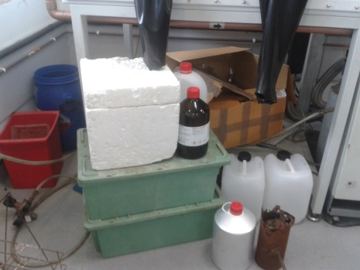
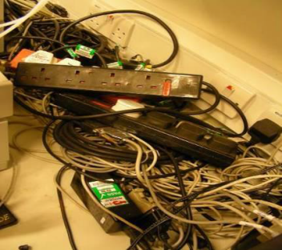
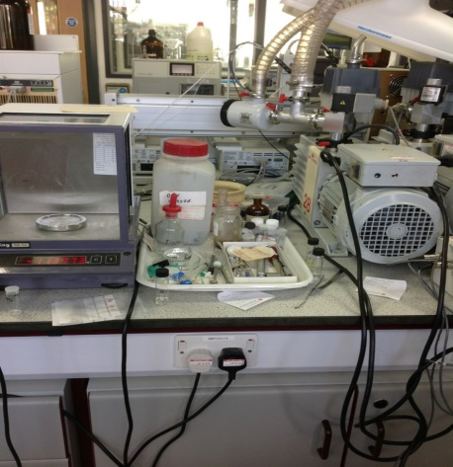

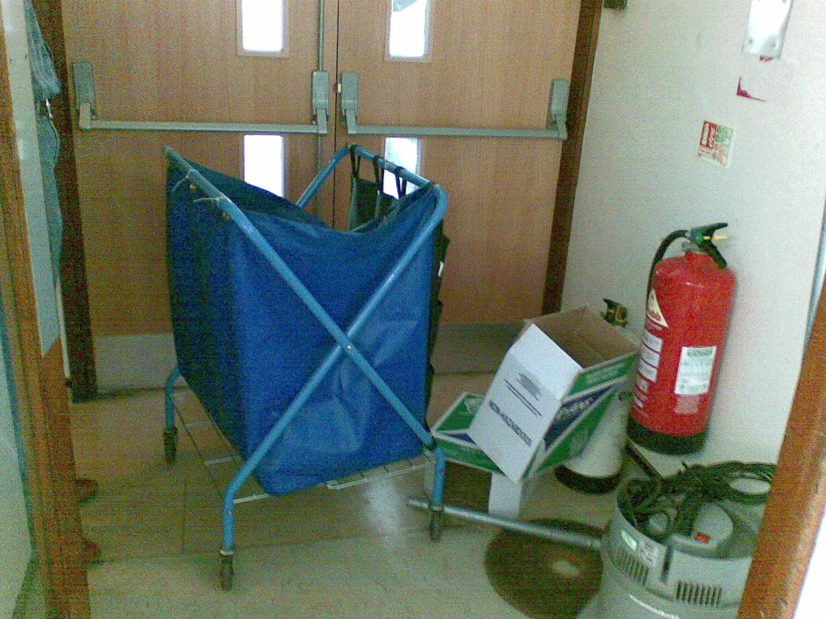
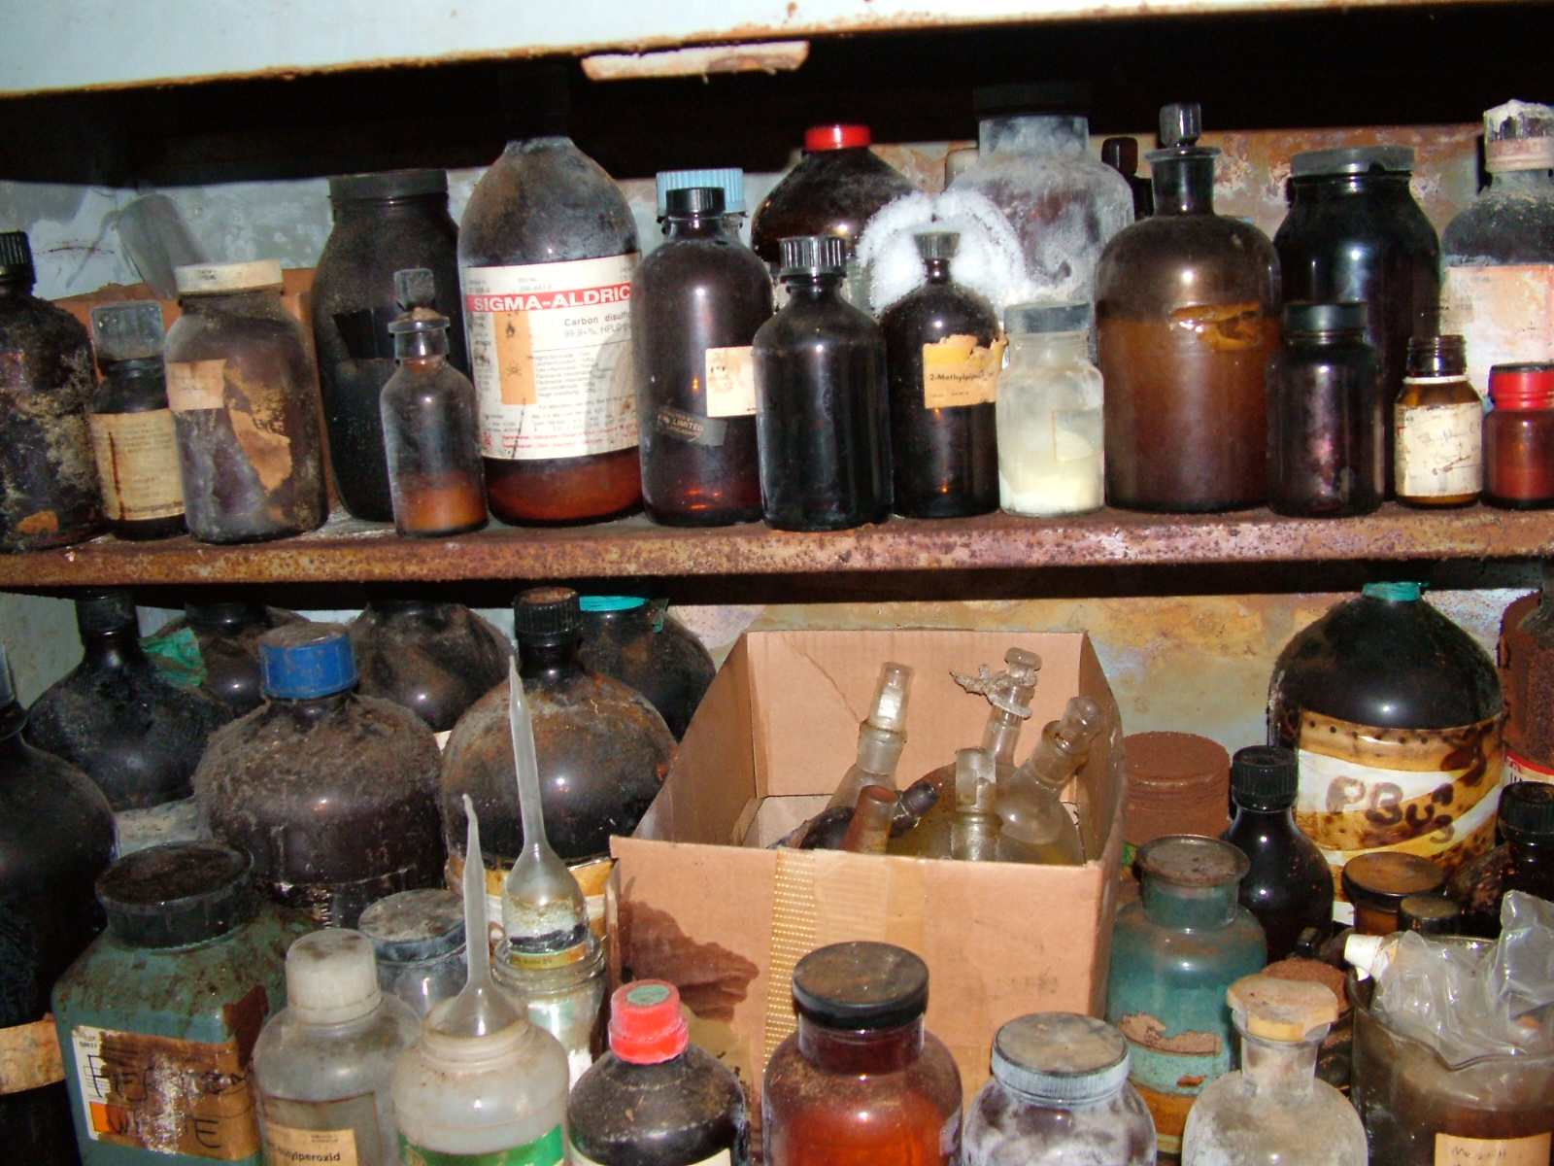
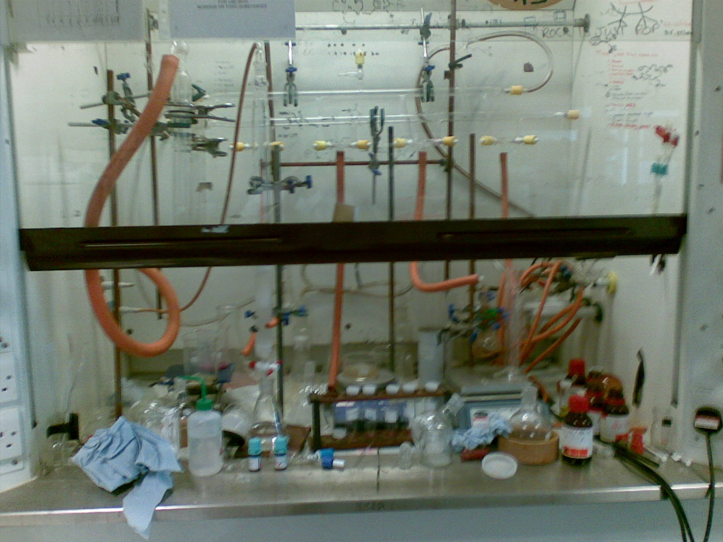
Housekeeping
Good housekeeping is essential to ensure a clean, safe and pleasant work environment.
To avoid incidents, accidents and fires lab benches, equipment and fume hoods must be wiped down regularly.
Do not block fire exits
Keep your working area clean, tidy and clutter free.
Remove unnecessary items and dispose of unwanted or out of date chemicals.
Don’t store heavy items at height.

