Slide 1
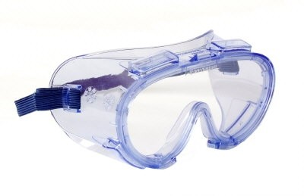
If you are handling pressured solvents or syringes
WEAR A PAIR

