Slide 1
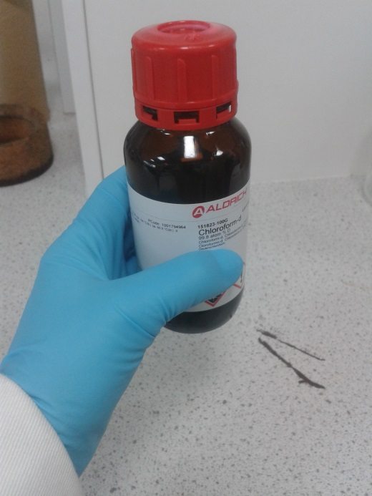

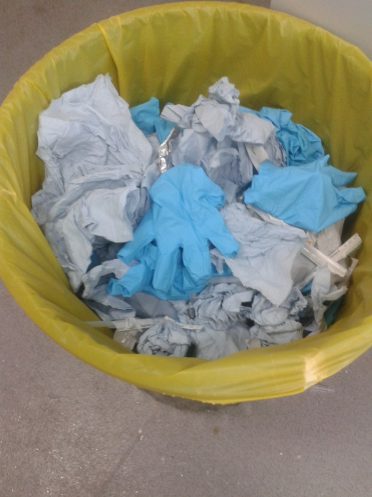

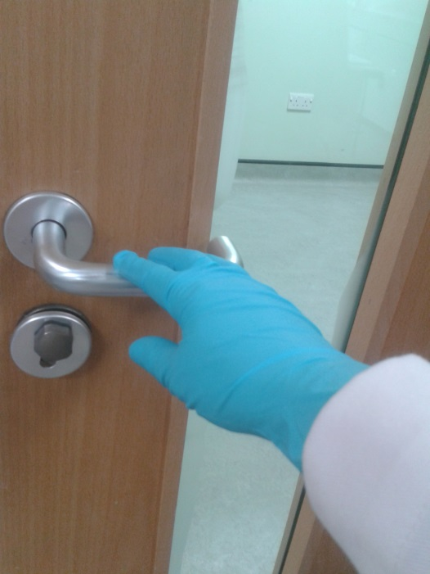
Gloves
Gloves should be changed regularly.
Wear gloves when handling chemicals
Do not attempt to re-use disposable gloves.
Never wear possibly contaminated gloves outside of the work area or to open doors, handle telephones, computer keyboards, etc.
Wash hands after removing gloves.
Gloves must be disposed of in yellow clinical waste bags.

