Slide 1
2D J-Spectroscopy and DOSY
Nuclear Magnetic Resonance – Theory and Techniques
Ralph W. Adams
ralph.adams@manchester.ac.uk

Slide 2
Introducing 2D J-Spectroscopy
Rather than using scalar (J) couplings to correlate signals, here we aim to separate them from chemical shift

Slide 3
Heteronuclear J-resolved Spectroscopy
In the heteronuclear version of the J-resolved experiment, the chemical shift of the X spin is presented in f₂ while couplings to a second nucleus, typically protons, are presented in f₁.
The f₁ dimension therefore enables an analysis of resonance multiplicity as well as measurement of heteronuclear-coupling constants (J_{XH}).

Slide 5
Measuring Long-Range Proton–Carbon Coupling Constants
Long-range ¹H–¹³C coupling constants can be used to define molecular configuration or conformation
J-resolved methods are well suited to such measurements, but suffer from the presence of the far greater ¹J_{CH} couplings
If less informative one-bond ¹H–¹³C couplings are suppressed from f₁ spectral width can be reduced and higher resolution can be achieved
¹J_{CH} values are greater than c. 125 Hz, while long-range couplings are typically less than 10 Hz

Slide 6
¹³C detected

Slide 7
¹H detected - The H1’ proton has been selectively inverted, and the doublet splittings in f₁ record its long-range couplings to C8 and C2’.

Slide 8
Homonuclear J-resolved Spectroscopy
The homonuclear version of the J-resolved experiment is most frequently applied in proton spectroscopy, although it is suitable for any abundant nuclide.
The separation of δ and J should reveal proton multiplets in f₁, and singlets in f₂ at the corresponding chemical shifts, such that the f₂ projection represents the ‘broadband proton-decoupled proton spectrum’.
Generates ‘pure shift’ spectrum and allows measurement of homonuclear-coupling constants.

Slide 9
The homonuclear sequence closely resembles the heteronuclear methods
The appearance of the homonuclear spectrum is different from its heteronuclear equivalent in that both chemical shifts and couplings appear in f₂.
Multiplets appear at 45 degrees
to either axis.
Columns parallel to f₁ do not
display the expected proton
multiplets, and the f₂ projection
displays both chemical shifts
and scalar couplings.

Slide 10
Processing
To reach the ultimate goal of retaining only chemical shifts in f2, it is possible to eliminate the couplings from by ‘tilting’ the multiplets through an angle of 45 degrees about their midpoints.
The resulting spectrum then has an appearance similar to the heteronuclear analogue, with columns parallel to f1 reproducing the multiplet structures.
Magnitude calculation must be performed so signals will have their amplitudes and shapes distorted.
If the whole data set is symmetrised about f₁ = 0 the multiplets are retained whereas contributions from the sloping t₁ noise and other spectral impurities are diminished.

Slide 11
(a) The 2D J spectrum after tilting and symmetrisation. The f2 projection (b) approximates to the ‘proton-decoupled proton spectrum’ and is considerably less complex than the conventional 1D spectrum (c). 4K t2 data points were acquired for 64 t1 increments over spectral widths of 5 ppm and 60 Hz, respectively. The final f1 resolution after zero-filling was 0.5 Hz/pt. Data were processed with unshifted sine bell windows in both dimensions and are presented in magnitude mode

Slide 12
(a) Selected f1 traces taken from a J-resolved spectrum and (b) equivalent multiplets from the 1D proton spectrum.

Slide 13
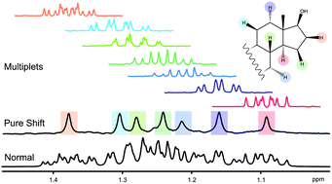

Slide 14
Introducing DOSY
Rather than correlating spins with each other, we measure their change in position over time to determine how the molecule to which the spin is attached diffuses in the solution.
Diffusion coefficients can then be used to infer information about the molecules.

Slide 15
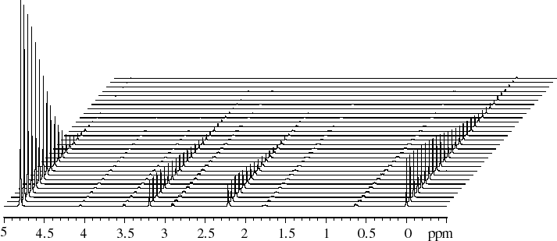
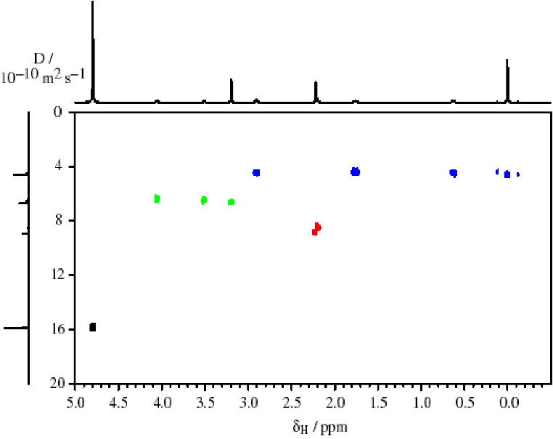
Constructing a 2D DOSY spectrum
PFGSTE spectra are measured as a function of G.
By fitting peak heights to the Stejskal-Tanner equation diffusion coefficients, D, are obtained.
1D peaks are extended into a second dimension, with Gaussian shapes centred on the D’s and widths determined by the standard errors σ_{D}.
G
DSS
Choline
Acetone
HDO
400 MHz ¹H DOSY spectrum of choline,
acetone and DSS in D₂O

Slide 16
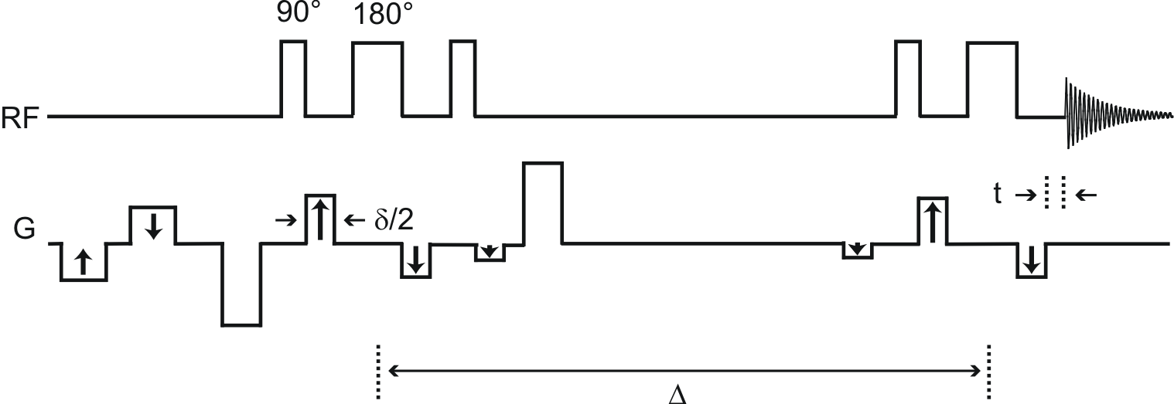
How do we acquire a DOSY spectrum?
Appropriate parameter settings
Pulse calibration
Recycle time
Acquisition time, etc
Strengths of greatest and smallest diffusion gradient levels
Diffusion gradient pulse width
Number of gradient levels
Diffusion time
nmr.chemistry.manchester.ac.uk

Slide 17
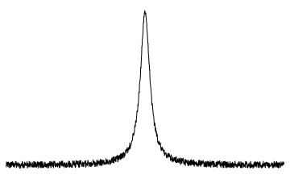
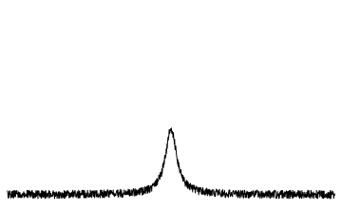
Optimising parameter settings
Good fitting to the Stejskal-Tanner equation can normally be achieved if the signals in the spectrum with most attenuation have intensity ≈1/e of those in the spectrum with least attenuation.
Acquiring the spectra with the greatest and smallest gradient levels from the full DOSY series, with a reduced number of transients, allows parameters to be appropriately set.
S₁
S₁
e
nmr.chemistry.manchester.ac.uk

Slide 18
Optimising parameter settings
Diffusion time
Strengths of strongest and weakest diffusion gradient levels
Diffusion gradient pulse width
Number of gradient levels
Choose Δ short compared to T₁.
Set to highest available for the strongest level and lowest available for weakest level (while maintaining CTP if using Oneshot type sequences).
Adjust value to get desired signal attenuation.
For mono-exponential fitting choose 10.
S₁
S₁
e
nmr.chemistry.manchester.ac.uk

Slide 19
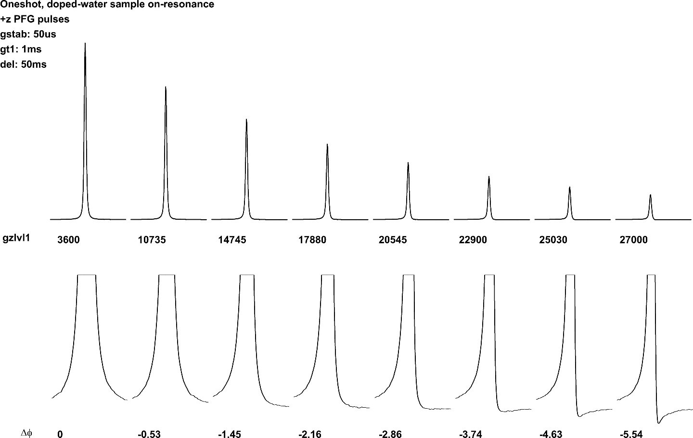
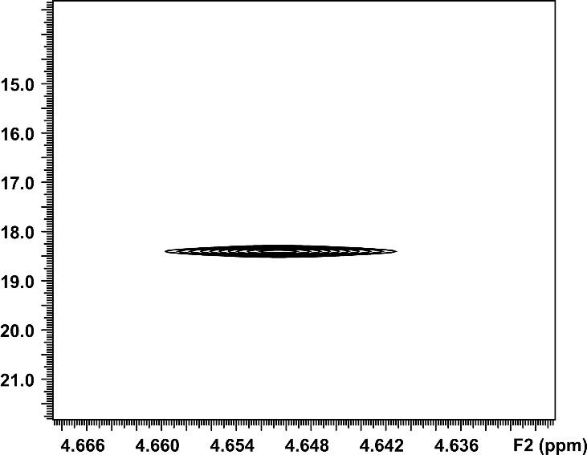
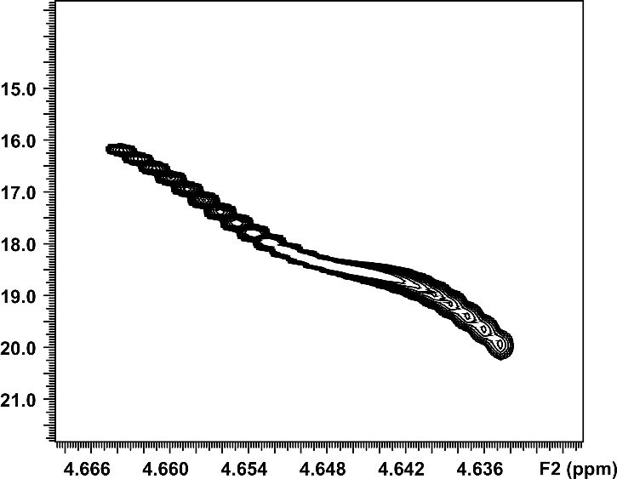
Acquire the DOSY
DOSY spectra should be acquired with the gradient strength incremented in steps of gradient².
Signal attenuation in a DOSY experiment
D / x10⁻¹⁰ m² s⁻¹
DOSY spectrum
nmr.chemistry.manchester.ac.uk

Slide 20
Phase dependence on gradient strength
In addition to the desired signal attenuation, there is often a phase change that results from the change in gradient strength.
The phase change can usually be reduced by increasing the gradient stabilisation delay (gstab/d16).
Use of reference deconvolution can completely remove the effects of phase change.
Signal phase in a DOSY experiment
nmr.chemistry.manchester.ac.uk

Slide 21
Reference Deconvolution
Synthetic
Reference
Peak
IFT
Experimental NMR Spectrum
C =
Ideal Ref. FID
IFT
Experimental Ref. FID
C
=
Experimental FID
Reference Deconvoluted FID
FT
Reference Deconvoluted NMR Spectrum

Slide 22
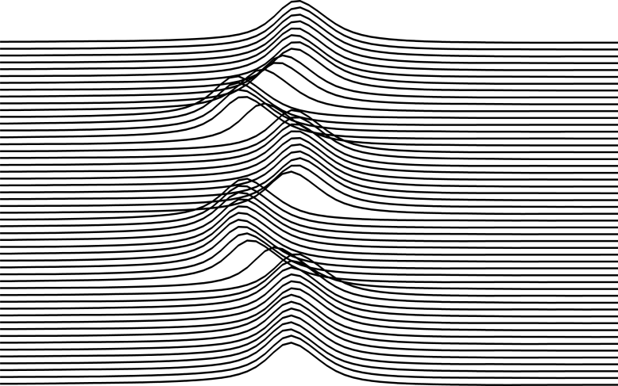
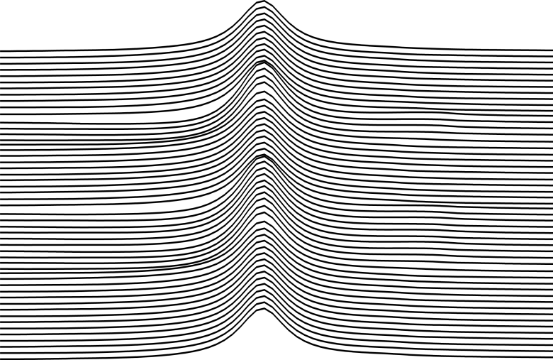
Reference Deconvolution
Reference
Deconvolution
Benefits for DOSY data
Requirements
Resolution enhancement
Frequency correction
Phase correction
Singlet (TSP)
Adequate amplitude in all spectra
nmr.chemistry.manchester.ac.uk

Slide 23
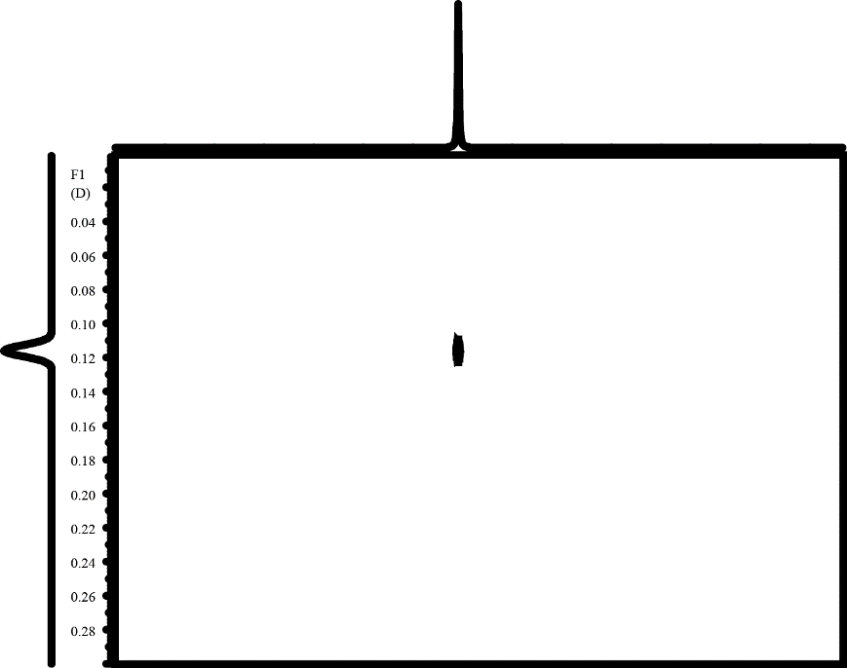
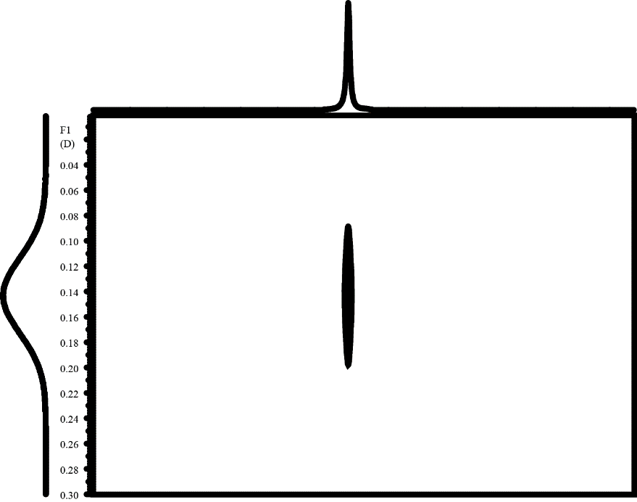
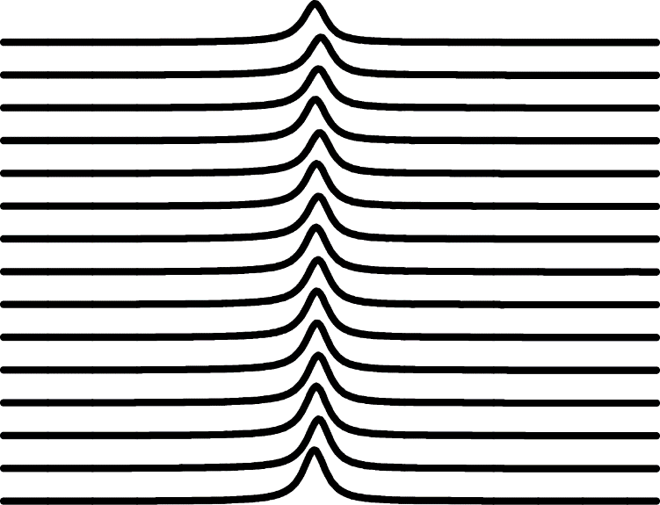
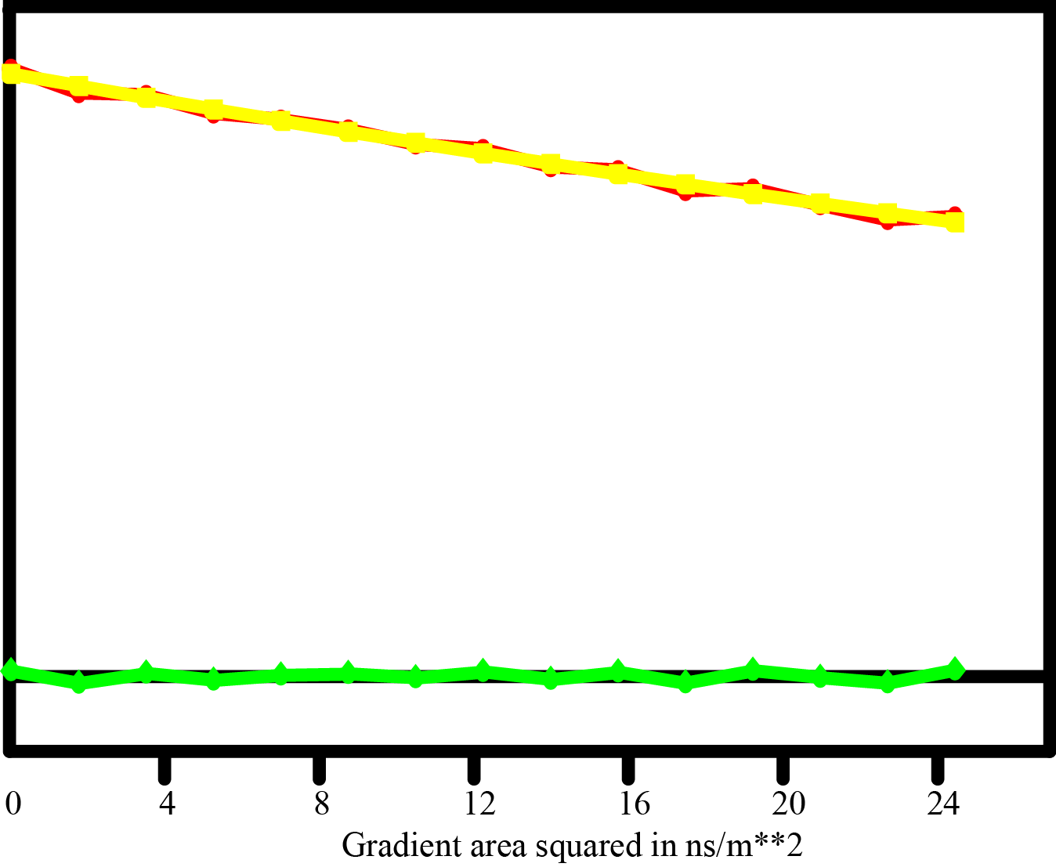
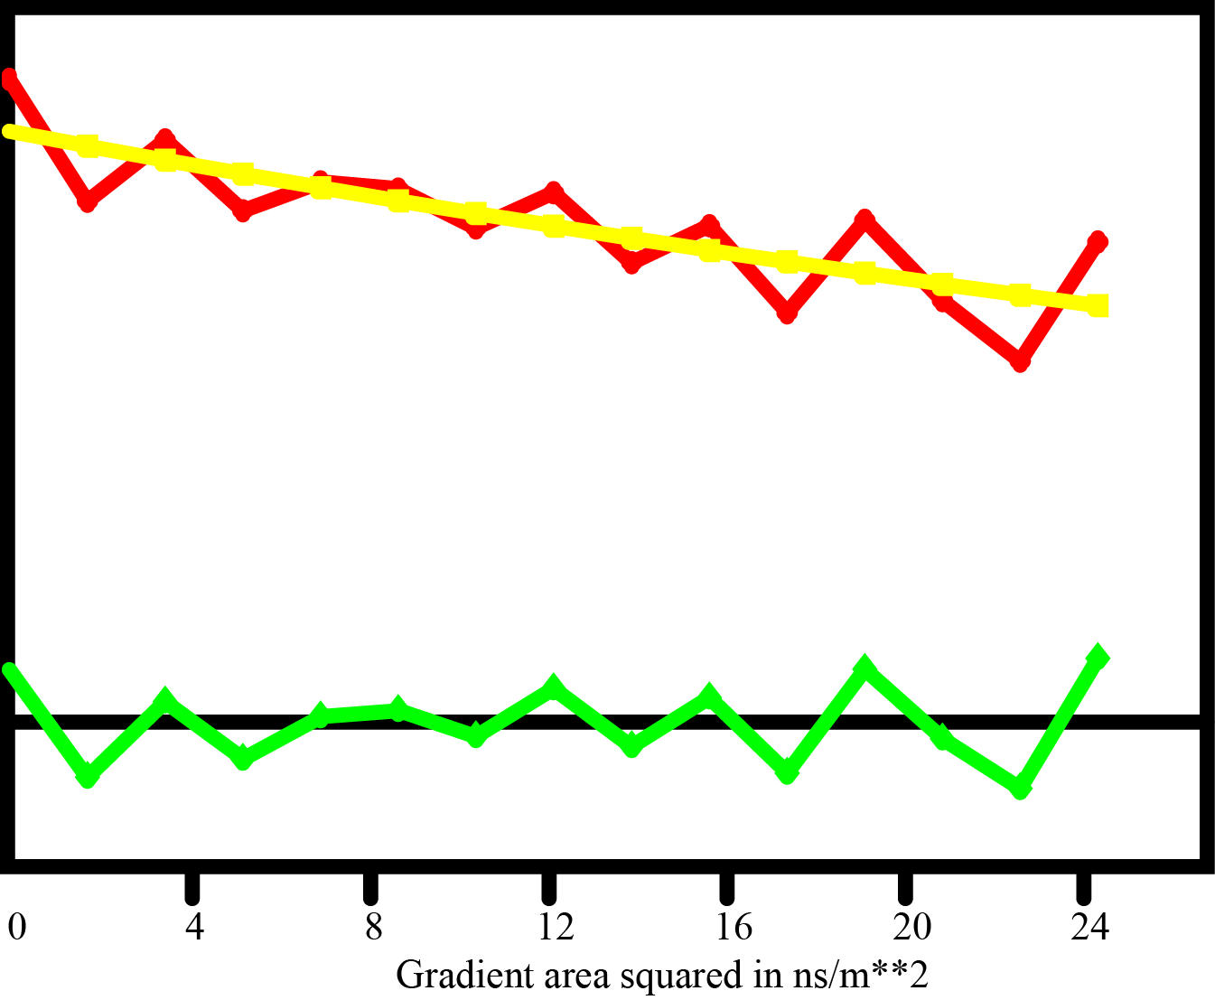
Reference Deconvolution

Slide 24
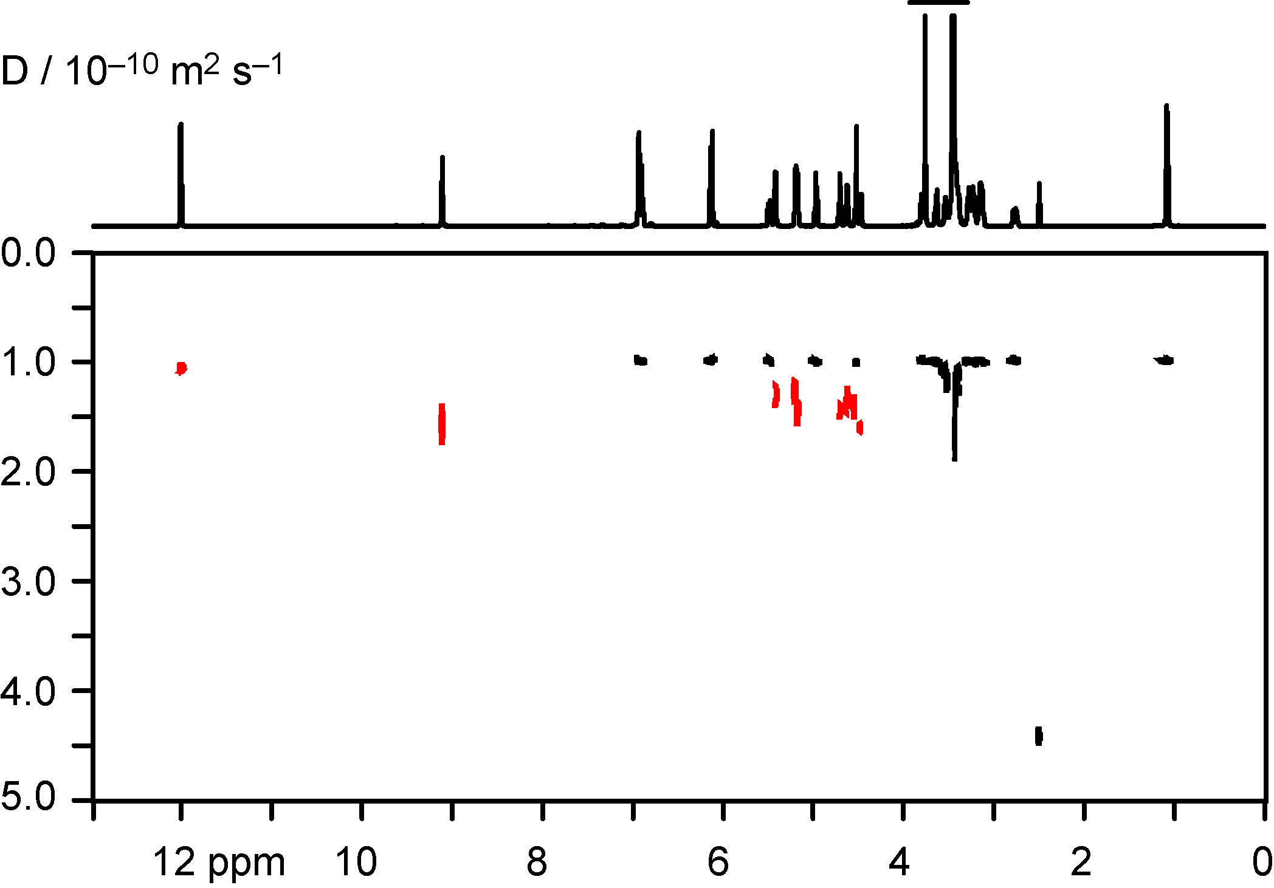
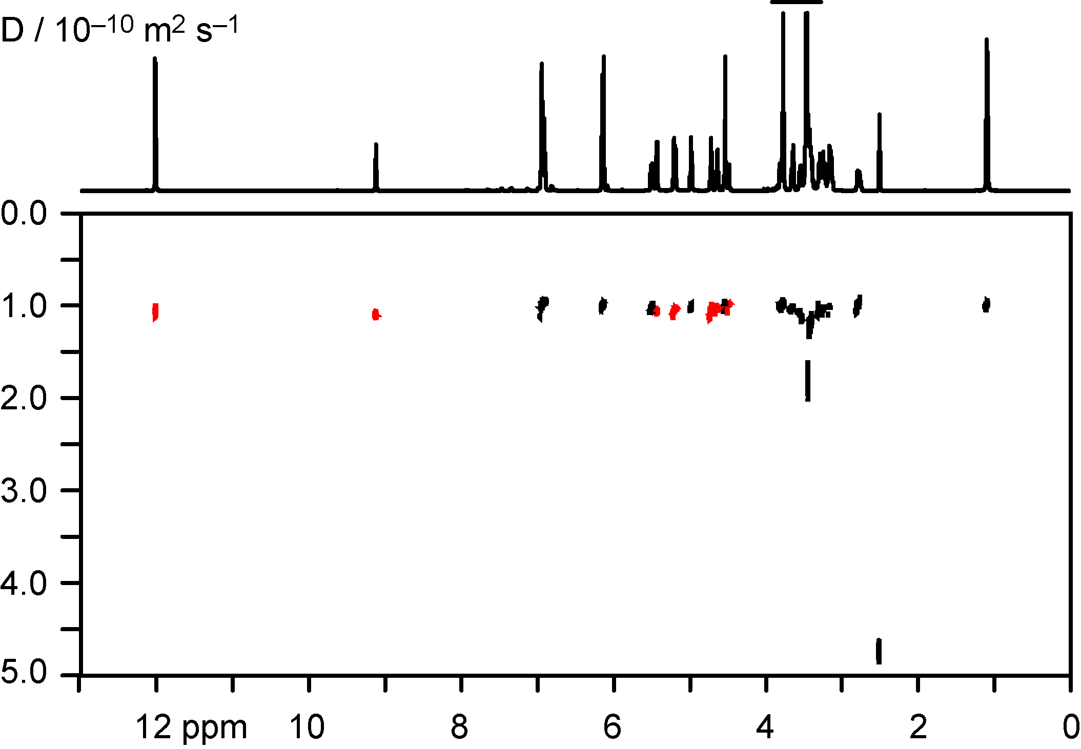
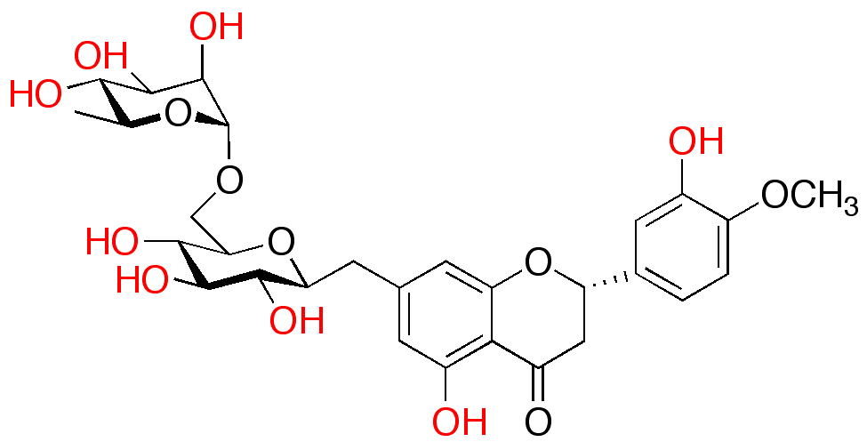
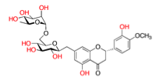
Chemical Exchange
OH H₂O exchange in hesperidin in dmso-d₆
Exchange during the diffusion delay of the Oneshot45 stimulated echo leads to averaging of diffusion coefficients.
Exchange in PROJECTED (PROJECT Extended for DOSY) leads only to signal loss, not to diffusion averaging, because the magnetization remains transverse during the diffusion delay.
nmr.chemistry.manchester.ac.uk

Slide 25
2D J-Spectroscopy and DOSY
Nuclear Magnetic Resonance – Theory and Techniques
Ralph W. Adams
ralph.adams@manchester.ac.uk

