Slide 1
The Nuclear Overhauser Effect (NOE)
Nuclear Magnetic Resonance – Theory and Techniques
Ralph W. Adams
ralph.adams@manchester.ac.uk

Slide 2
Introducing NOE
The nuclear Overhauser effect
Previously we have looked at experiments that exploit ‘scalar’ coupling
NOE interactions occur through dipolar coupling
NOE is normally used after the majority of the structure of a molecule has been characterised.
NOE is also used routinely for sensitivity enhancement

Slide 3
Principal applications of NOE

Slide 4
NOE
The NOE may be defined as the change in intensity of one resonance when the spin transitions of another are perturbed from their equilibrium populations.
Saturate a resonance, that is equalising the spin population differences across the corresponding transitions
Inverting a resonance (inverting the population differences across the transitions).

Slide 5
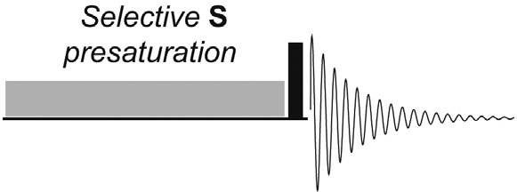
Steady state NOE
Steady-state NOE signals are brought about by saturating specific spin transitions by selective application of weak radiofrequency (rf ) irradiation to a resonance.
This form of the NOE is observed with the largely deprecated NOE difference method.

Slide 6
Origin of the NOE
Consider two homonuclear spins-½ that exist in a rigid molecule which tumbles isotropically (has no preferred axis about which it rotates) in solution.
The two nuclei do not share a scalar coupling, but do share a dipolar coupling.
Dipolar coupling is the direct, through-space magnetic interaction between the two spins such that one spin is able to sense the presence of its dipolar-coupled partner.
This coupling may be viewed as being analogous to the interaction one witnesses when two bar magnets are brought close together.

Slide 7
Population differences and cross relaxation
(a) At equilibrium, (b) after instantaneous saturation of the S spins, (c) after relaxation via ‘W₂’ processes and (d) after relaxation via ‘W₀’ processes. Below each are the corresponding schematic spectra.
The W labels represent transition probabilities – the rates at which the corresponding spin-flips occur.

Slide 8
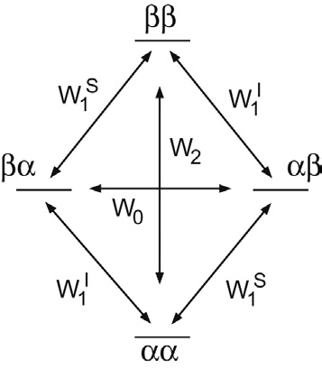
W₂ and W₀ cross-relaxation processes compete with one another, with the dominant pathway dictating the sign of the observed NOE
W₁ pathways quench NOE

Slide 9
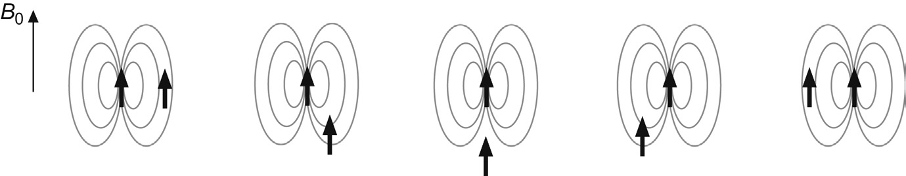
The NOE arises as a result of the redistribution of spin populations and hence flips between spin states.
Redistributions occur via longitudinal (T₁) relaxation, which is not spontaneous and requires a magnetic field fluctuating at the field of the corresponding transition
The dipolar coupling between spins is acutely sensitive to the internuclear separation r, being proportional to r⁻³

Slide 10
Correlation Time
Rotational correlation time τ_{c} is the rate at which a molecule tumbles in solution (the average time required for the molecule to rotate through an angle of one radian about any axis
Rapidly tumbling molecules possess small correlation times while slowly tumbling molecules have large correlation times.
A very rough estimate of this time for a molecule of mass Mr may be obtained from the relationship:
τ_{c} = M_{r} × 10⁻¹² s

Slide 11
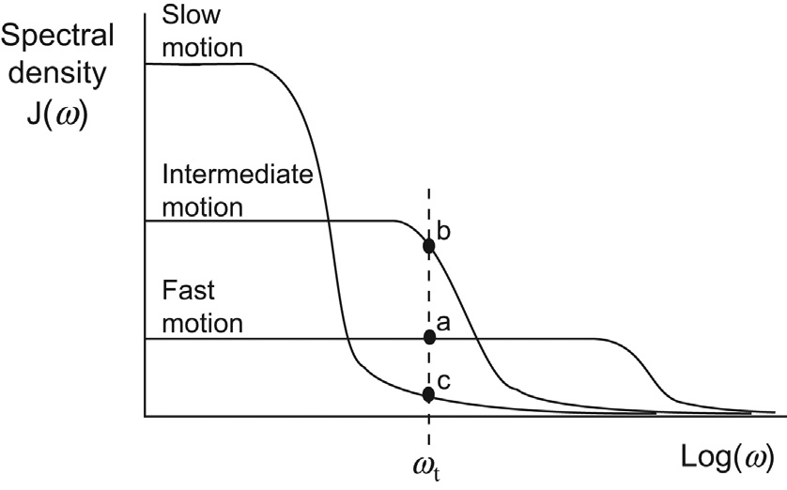
Spectral Density
The power available within a molecular system to induce transitions by virtue of its molecular tumbling is referred to as the spectral density J(w)
J(w) provides
a measure of
how the
relaxation rates
W₀, W₁ and W₂
vary as a
function of
tumbling rates.

Slide 12
molecules which tumble rapidly in solution are likely to favour the higher energy W₂ process and hence exhibit positive NOEs
molecules that tumble slowly will favour the W₀ process and thus display negative NOEs

Slide 13
τ_{c} depends on the size and shape of the molecule, solution conditions (viscosity, temperature, possibly pH, etc.) and spectrometer field strength
The use of a higher field strength increases the likelihood of a relatively ‘small’ molecule falling within the intermediate regime.
As a rule of thumb, molecules with a mass of 1000–2000 Da are likely to fall within this intermediate regime

Slide 14
Heteronuclear NOEs
For ¹³C observation in the presence of proton saturation (broadband decoupling) NOE enhancements can be as much as 200% or a threefold intensity increase.

Slide 15
Effect of other relaxation
Maximum homonuclear steady-
state NOE in the presence (solid
line) and absence (dotted line) of
external relaxation sources that
compete with cross-relaxation.

Slide 16
Tips for maximising the size of the NOE
Remove paramagnetic oxygen dissolved in solvents. Degassing of solutions prior to NOE studies may become necessary when seeking longer range interactions in small molecules, but is otherwise unnecessary for the majority of routine studies.
Other paramagnetic impurities will quench the NOE and must be avoided. Samples to which relaxation agents have been deliberately added to promote relaxation are not suitable candidates for NOE studies.
Solvent molecules are deuterated in most cases, so the relaxation arising from these nuclei is rather inefficient when compared with protons and interactions with other (protonated) solute molecules are generally only likely to be a problem when very concentrated solutions are used, so these are thus best avoided for NOE studies.
Avoid molecules which show relaxation associated with nuclei with spin >½. This is usually the dominant mechanism for such nuclei, so NOEs on quadrupolar nuclei are very rarely observed (the exception being ⁶Li)

Slide 17
Applications – E vs Z
The differentiation of E and Z alkene isomers is often possible by direct measurement of vicinal proton–proton couplings across the unsaturation, whereby cis and trans couplings are usually sufficiently different to allow a distinction to be made (typically J_{cis} 7–11 Hz, J_{trans} 12–18 Hz).
When only a single alkene proton exists this method can no longer be used and the NOE then offers an alternative approach provided a protonated group exists across the double bond.

Slide 18
Applications – Aromatic Substitution Position
Determining the position of substitution within a molecule can also be problematic when no direct proton–proton couplings exist.
Particularly when dealing with aromatic systems, the NOE can often provide unambiguous solutions. These systems are particularly favourable because they are restricted to being planar and, hence, it is usually safe to assume that nearest neighbours will be those on adjacent positions in the ring.
Prior to the use of the NOE, differentiation was possible only through chemical degradation or through empirical rules based on differences in the small (<1.5 Hz) H2–H5 coupling constant.
An alternative approach to consider nowadays in such cases would be to establish connectivity by identifying long-range proton–carbon correlations across the heteroatom via the heteronuclear multiple bond correlation (HMBC) experiment.

Slide 19
Applications – Substituent Configuration
Arguably the most common problem the NOE is
used to address in synthetic chemistry, is the
relative configuration of substituents on ring
systems.
For six-membered rings in particular, direct analysis
of proton-coupling constants within the ring can in itself be informative because of the generally distinct differences in axial–axial versus axial– equitorial/equitorial–equitorial coupling constants in chair conformations
(eg ax–ax ≈ 10–12 Hz, ax–eq/eq–eq ≈ 2–5 Hz).
However, in determination of the orientation of the methyl group here these would not have been informative, because of the similarity between ax–eq and eq–eq coupling constants.

Slide 20
Vicinal couplings in five-membered rings generally offer greater ambiguity in defining relative configurations and here careful NOE measurements are also required since cis and trans NOEs between adjacent protons are often of similar magnitude.
In these cases it is wise to collect as many NOE enhancements as is possible for the sample and to ensure self-consistency over all of these within the proposed stereochemistry.

Slide 21
Applications – Resonance Assignment
Most NOE studies first require
assignment of the proton
spectrum
In some cases the NOE can be
used for resonance assignment.
It is most likely to be of use for
assigning resonances of isolated
groups that share no proton
scalar couplings, although it is
by no means limited to this.
The use of long-range heteronuclear correlation experiments should also be considered when addressing such problems, and may be needed in determination of the gross structure in the first place.

Slide 22
Applications – Endo versus Exo Adducts
NOE can be
used to
distinguish
exo and endo
adducts in
fused ring
systems
In such cases the NOE patterns observed between the proton(s) at the junction and those on the adjacent rings can often provide an unambiguous stereochemical assignment.
Here the bridgehead proton was in fact too heavily overlapped with an adjacent resonance to be selectively saturated, although NOEs on to this were quite distinct.
When bridgehead protons cannot be used at all, or if non-existent, the assignment must then rely on the observation of NOEs between ring protons on either side of the junction.

Slide 23
Applications – Conformational Preference
The definition of a favoured
conformation in small, flexible
molecules by use of the NOE
is very difficult.
Rapid interchange between many
possible conformations means the NOE
will represent a weighted average of
internuclear separations
present within the conformers.
When restricted conformational
processes lead to one conformation
being strongly favoured, sufficient NOE data may be available which allow this to be defined.
Examples include the differentiation of chair and boat conformers of cyclohexanes or of slowly interconverting rotamers.
Specific conformations may also be favoured in the presence
of steric hindrances or strong hydrogen-bonding interactions.

Slide 24
Mixing

Slide 25
Some tips for setting up NOE experiments
For quantitative measurements, mixing times must be significantly shorter than the T₁ relaxation time of spin I (observed, not saturated/irradiated) must be used.
If the goal is to qualitatively identify through-space correlations, as is more often the case in routine work, mixing periods comparable with T₁ provide maximum enhancements.

Slide 26
Rotating Frame NOEs (ROESY)
An experiment (ROESY) is available that avoids the zero crossing point

Slide 27
1D NOESY
FIGURE 9.36 Selected 1D gradient NOESY spectra of the bicyclic lactam 9.11 recorded with a mixing time of 800 ms. Spectrum (a) is the conventional 1D spectrum, and the strong geminal H49–H4 NOE in (c) has been truncated.

Slide 28
2D NOESY
Watch out for
chemical exchange

Slide 29
CSSF, Doubly Selective TOCSY-NOESY, HSQC-NOESY, and 2D-pure shift-NOESY
1D selective NOESY experiments need a well-resolved peak for selective inversion
One approach is to incorporate a chemical shift selective filter (CSSF) in the 1D NOESY sequence. The CSSF enables selection of a single resonance at a specified chemical shift even when the resonance is overlapped with others
An alternative approach is to employ a selective transfer preparation step from a well-resolved resonance onto the overlapped target resonance so as to reveal this. This leads to a concatenated or doubly selective experiment for which a selective TOCSY preparation element is well suited to generating the initial transfer.
HSQC can also be used, with a selective pulse used at the chemical shift of the ¹³C connected to the ¹H of choice.
If resonances overlap in a high resolution 2D NOESY, pure shift methods can often be used to resolve the signals.

Slide 32
¹³C HOESY (¹⁹F is more sensitive)

Slide 33
Experimental considerations for NOE measurements
Well-prepared sample
Sovent (viscosity) and sample temperature has greater influence on the NOE than for most experiments (useful for mid-sized molecules close to the zero NOE condition
It is worth avoiding very high solute concentrations
Paramagnetic impurities should be removed, notably certain metal ions and molecular oxygen. Metal ions can be removed by filtration through suitable chelating resins whereas oxygen may be removed with the freeze–pump–thaw method. In general, the smaller the molecule and the further the internuclear separations being investigated, the greater the gain from solvent degassing.
The use of lock solvents with temperature-dependent shifts, notably D₂O, calls for particular attention regarding temperature stability and will likely benefit from active temperature regulation if experiments are to be acquired over some hours.
Sample spinning is usually detrimental to NOE experiments.

Slide 34
The NOE is the change in intensity of the resonance of a nuclear spin, I (‘interesting’), when the population differences across the transitions of a near neighbour, S (‘source’), are perturbed from their equilibrium values, usually by saturation or by population inversion. It arises as the perturbed spin system alters its spin populations in an attempt to regain the equilibrium condition.
Steady-state NOEs are those measured after a period of continuous S-spin saturation during which a new ‘steady-state’ equilibrium condition has developed for the I-spin populations. The NOE enhancement is usually denoted ηI{S} and may be quantified as a percentage.
Steady-state NOEs can provide information on relative internuclear distances only—not on absolute measurements of internuclear separation.
The NOE only arises between nuclei that share a mutual dipolar coupling (a direct, magnetic through-space interaction) and thus relax each other via the dipole–dipole relaxation mechanism. Only this mechanism contributes to the nuclear spin population changes that produce the NOE, which is intimately related to longitudinal spin relaxation. The dependence on internuclear separation that makes the NOE so useful has its origins in the strength of dipolar coupling between two spins, this being inversely proportional to their separation rIS (as rIS–3).
Longitudinal spin relaxation requires a stimulus in the form of a magnetic field fluctuating at a frequency equal to the frequency (energy) of the transition. In the case of dipolar relaxation, this arises from the time-dependent field a spin experiences from its dipolar-coupled neighbour as the molecule rotates or tumbles in solution. The NOE in turn is dependent upon the rates of molecular tumbling.
The magnitude and sign of the NOE results from competition between various relaxation pathways. If the W2 (aa ↔ bb) pathway dominates, positive NOEs are observed whereas a dominant W0 (ab ↔ ba) pathway leads to the observation of negative NOEs. The W2 and W0 relaxation pathways (which involve the mutual flipping of the two spins) are collectively referred to as cross-relaxation pathways, and it is only these that contribute to the generation of the NOE. All other contributions to relaxation, in the form of W1 processes (aa ↔ ba and ab ↔ bb, involving the flip of only a single spin), serve to reduce the overall magnitude of the effect, and are thus referred to as leakage contributions.
Rapid molecular tumbling, corresponding to a short correlation time τc, favours the higher energy W2 process, so small molecules in low-viscosity solvents display positive homonuclear NOEs (the extreme narrowing limit). In contrast, slow molecular tumbling (long correlation times) favours the lower energy W0 process, meaning large molecules or smaller molecules in high-viscosity solvents display negative homonuclear NOEs (the spin diffusion limit).
The maximum possible positive NOE is gS/2gI; in other words, 50% in a homonuclear system. Enhancements in heteronuclear systems can be far larger, for example 199 % from 1H to 13C, and can serve as a useful source of sensitivity enhancement in the observation of low-g I spin. They also become negative if one of the gs is negative, for example −494% from 1H to 15N, and may in some cases lead to severe signal reduction or even disappearance.
The maximum possible negative NOE in a homonuclear system is –100%.
Between the extreme narrowing and spin diffusion limits lies the difficult region in which NOEs can become zero (when w0τc ≈ 1) or at least rather weak, often demanding a change in experimental conditions or the use of rotating frame NOE measurements.
In an isolated homonuclear two-spin system in the extreme narrowing limit relaxing exclusively via the dipole–dipole mechanism, the steady-state NOE is predicted to be +50% and independent of internuclear separation rIS. However, the initial rate at which the NOE grows is proportional to rIS–6.
In a more realistic multi-spin system, neighbouring nuclei N that are close to I can also contribute to its W1 relaxation pathway. The magnitude of the NOE then becomes dependent on the I–S internuclear separation (inversely as rIS–6), but also has a dependence on the distance(s) between I and its near neighbour(s) (inversely as rIN–6), amongst other factors.
The direct consequence of this is that to correctly interpret steady-state NOE data, it becomes essential to consider not only the I–S internuclear separation, but also the proximity of all other nuclei (relaxation sources) surrounding I.
This also means that steady-state NOEs are rarely symmetrical. That is, the NOE observed at spin A on saturating spin B, ηA{B}, is unlikely to equal the reverse measurement from saturating A and observing B, ηB{A}. This is a consequence of the fact that the neighbours surrounding A are unlikely to match those surrounding B in number and in distance.
The relaxation of a spin with a very near neighbour will be dominated by this neighbour and, as a consequence, NOEs on this spin from a more distant source spin will tend to be small. Conversely, nuclei that have no nearby neighbours will experience relaxation only from distant neighbours and, as a result, NOEs from these neighbours will be large despite the relatively large internuclear distance involved. Thus, it is to be expected that NOEs over similar distances on a methylene and on a methine proton will generally be somewhat smaller for the methylene proton since this will always have at least one near neighbour, its geminal partner.
Longer range NOEs build up only slowly, due to the r–6 rate dependence, so require long saturation periods before becoming appreciable.
NOE enhancements may also be relayed on to neighbouring spins. For example, an NOE from A to B may be further passed onto a spin C that also cross-relaxes with B, such events being referred to as indirect effects. The properties of indirect enhancements differ markedly in the positive and negative NOE regimes.
When direct (A–B) NOEs are positive, indirect effects at C are weak and negative but are favoured when the three spins have an approximately linear relationship (so may provide useful geometrical information), develop only slowly with a characteristic lag time and are thus also favoured by long presaturation periods. These are referred to as three-spin effects. Although further relays are theoretically possible, they are generally too weak to be observed.
It is possible that positive direct effects and negative indirect effects can cancel or act to reduce the magnitude of the NOE. Thus, despite two spins being close, NOEs between them may be rather small or even negligible (particularly when longer saturation periods are employed).
When direct (A–B) NOEs are negative, indirect effects are also negative so cannot be distinguished, they spread rapidly and have high intensities. This process is referred to as spin diffusion and is fatal for the steady-state NOE since it causes a loss of specificity and hence provides no information on molecular geometry. In this regime, it usually becomes necessary to use kinetic (transient) methods based on the measurement of NOE growth rates.
Taking into account all the subtleties associated with the steady-state NOE presented above, it should be clear that it is unwise to place too much significance on the absolute magnitudes of steady-state NOE enhancements. In reality, differences of a few percent mean little when taken on their own, and it is generally necessary to consider a collection of enhancements when undertaking structural or conformational analysis to be certain of an unambiguous conclusion. A qualitative interpretation of many measurements is the most appropriate approach to interpreting most NOE data.

Slide 35
The Nuclear Overhauser Effect (NOE)
Nuclear Magnetic Resonance – Theory and Techniques
Ralph W. Adams
ralph.adams@manchester.ac.uk

