Slide 1
Relaxation, quantification, sensitivity, and signal averaging
Nuclear Magnetic Resonance – Theory and Techniques
Ralph W. Adams
ralph.adams@manchester.ac.uk

Slide 2
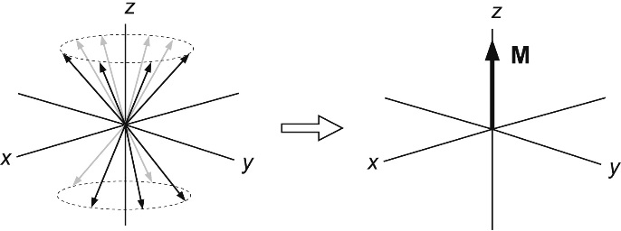
Bulk Magnetisation
The combined magnetic moments of all of the spins in the sample produce an overall magnetic moment known as a bulk magnetisation vector.
Figure 2.1.-03
Bulk magnetisation. Note that the representation on the left is not strictly true but gives the correct result. For the correct representation see M. Levitt, Spin Dynamics (2nd Ed.), Ch 2.

Slide 3
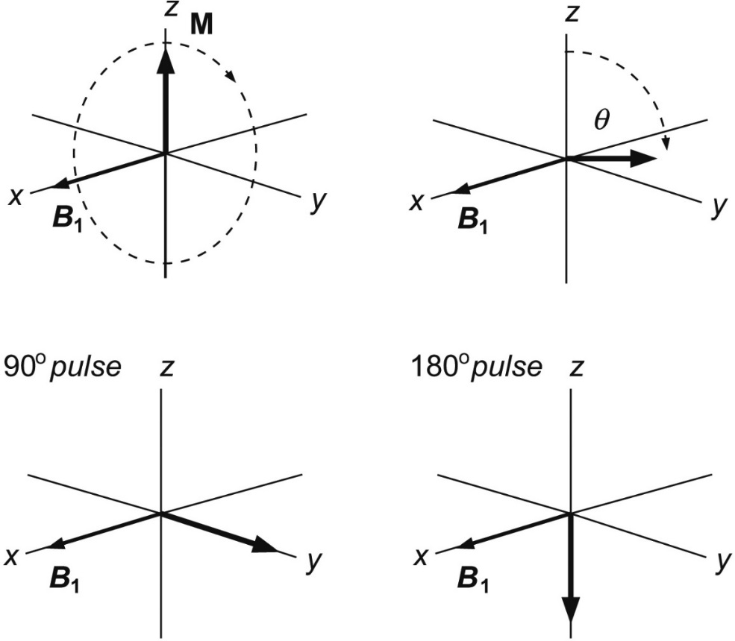
Radiofrequency (r.f.) Pulses
Applying an r.f. pulse at the
appropriate frequency causes
the bulk magnetisation vector
to rotate into the transverse
plane – where it can be
observed
Figure 2.1.-02
The radiofrequency (r.f.) pulse

Slide 4
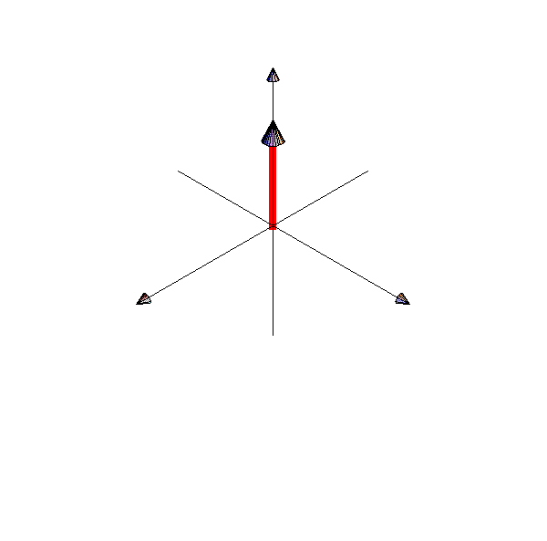
Acquiring an NMR signal
An r.f. pulse is switched on and the bulk magnetisation vector is rotated into the transverse plane.
The r.f. pulse is switched off
The detector is switched on and the bulk
magnetisation vector rotates at its
Larmor frequency, inducing a
current in the detector
Figure 2.0.-01
Trajectory of the bulk magnetisation in a simple NMR experiment
(animated gif)

Slide 5
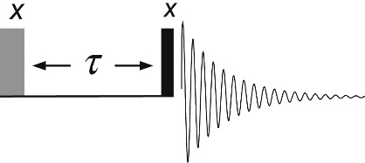
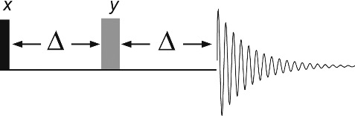
Pulse sequences
Pulse sequences in NMR are often represented by drawings
The x-axis is time, the components in the drawing represent rf pulses, delays, acquisition, etc.
Figure 2.1.01 The pulse-acquire sequence.
Figure 2.1.03 The spin-echo pulse sequence.
Figure 2.1.02 The inversion recovery sequence.

Slide 6
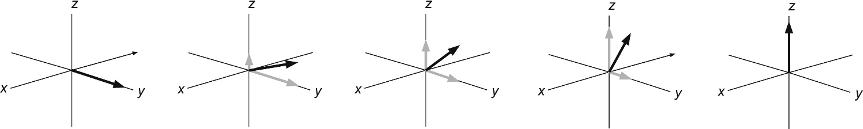
Longitudinal relaxation
An rf pulse moves the bulk magnetisation vector away from thermal equilibrium (+z-axis)
Recovery of magnetisation along the z-axis is called longitudinal relaxation
The return to thermal equilibrium follows an exponential trajectory with time constant T₁
Figure 2.1.04
Longitudinal relaxation
Longitudinal relaxation is also know as spin-lattice relaxation

Slide 7
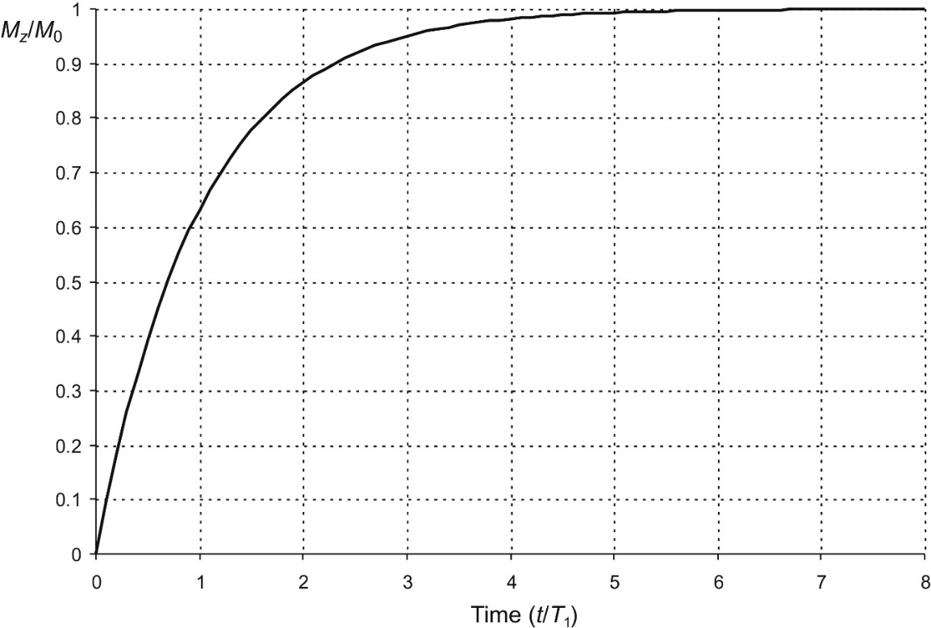
Longitudinal relaxation
Each signal has its own T₁, and it is dependent on magnetic field strength
When a sample is placed into a magnetic field it takes some time for the bulk magnetisation vector to form
the time required to reach thermal equilibrium is at least
5 x T₁
For quantitative NMR we must wait at least 5 x T₁ between rf excitation pulses
Figure 2.1.05
Longitudinal magnetization build-up
$$M_{z}=M_{0}(1−e^{{−t}/{T_{1}}})$$

Slide 8
Signal saturation
In NMR we typically combine the results from many experiments to improve the signal-to-noise ratio of a spectrum
If an NMR experiment is run with a very fast repetition rate – where the 90° excitation pulses in sequential experiments are << 5 x T₁ apart – the magnetisation does not return to equilibrium.
The result is a reduction in signal intensity as the signals cancel or become ‘saturated’
The two most common ways to prevent saturation are to increase the time between repetitions or to use a lower flip angle pulse, resulting in a longer total acquisition time, or a lower signal-to-noise ratio

Slide 9
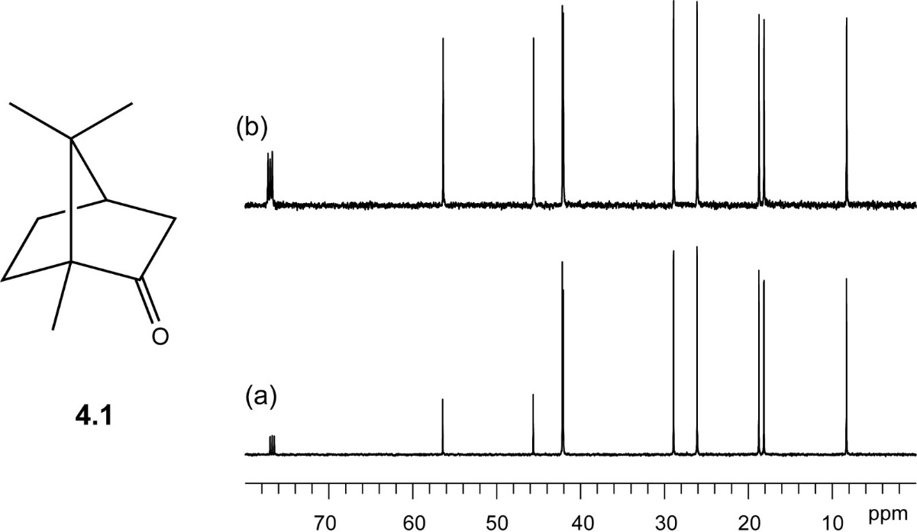
What happens if we pulse too rapidly?
Figure 2.1.09 Carbon-13 spectra of camphor 4.1.

Slide 10
Measuring T₁
T₁ can be measured in several ways.
One of the simplest is to invert the magnetisation with a 180° pulse, then allow it to relax for a time, τ, before applying a 90° pulse to measure the signals.
Several experiments are performed with different values for τ.
Signal intensity is plotted against τ to determine T₁.
Figure 2.1.06
The inversion recovery pulse sequence.

Slide 11
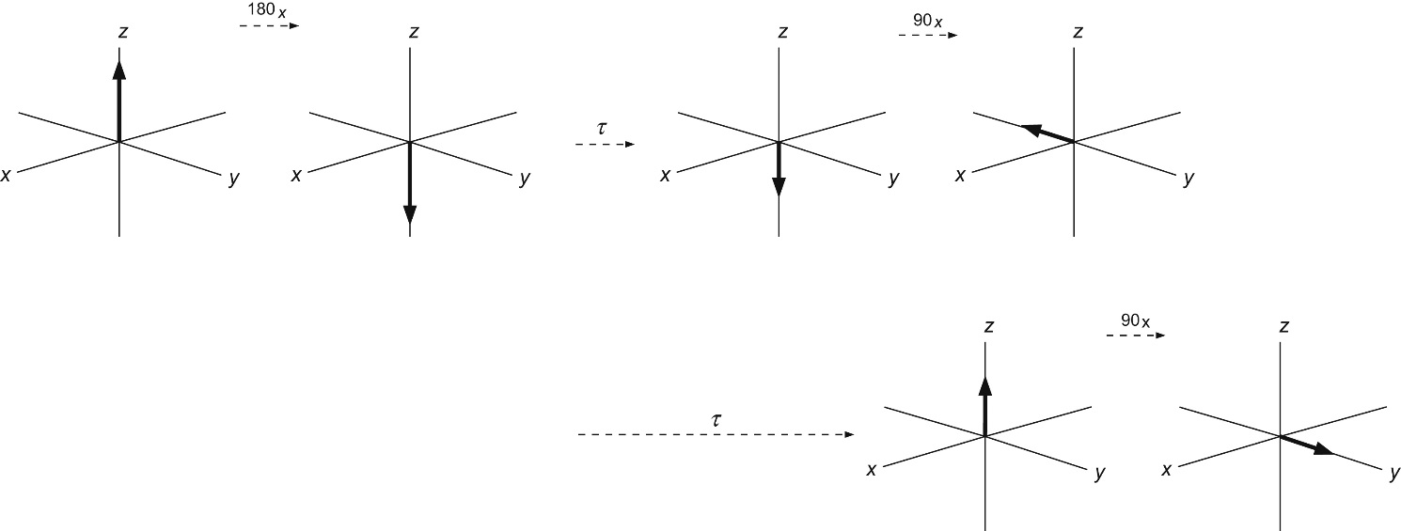
Measuring T₁ – inversion recovery
Figure 2.1.07
The inversion recovery process.

Slide 12
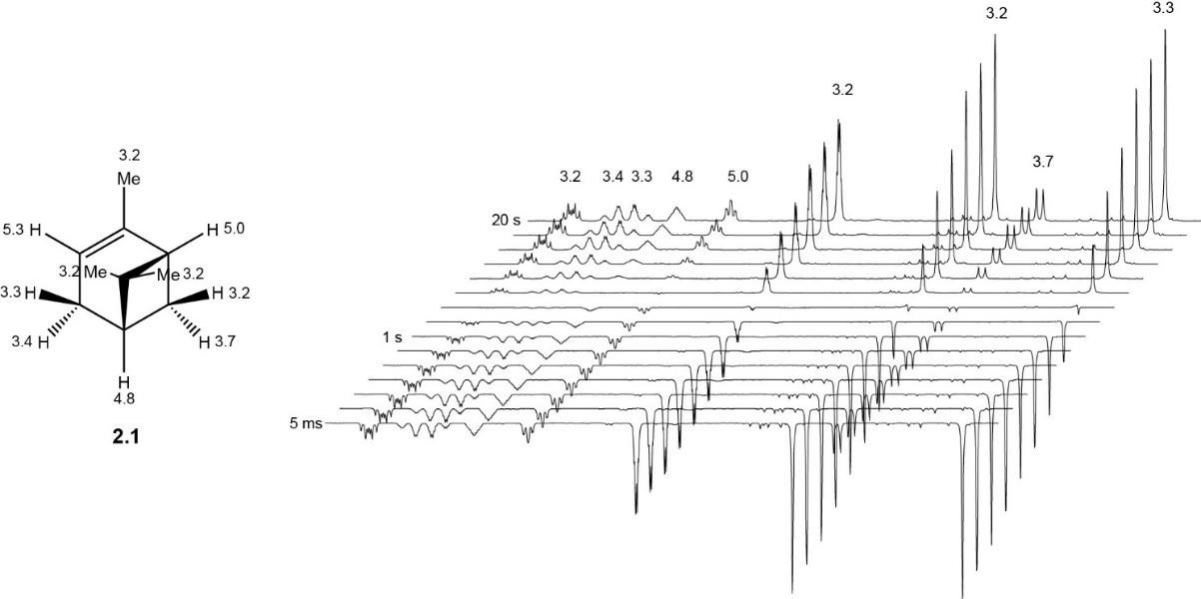
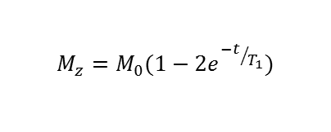
Measuring T₁ – inversion recovery
$$M_{z}=M_{0}(1−{2e}^{{−t}/{T_{1}}})$$
Figure 2.1.08
The ¹H inversion recovery experiment performed on α-pinene 2.1.

Slide 13
Quantification- qNMR
NMR provides high precision and accuracy when validated.
Best performed with ¹H due to sensitivity.
Requires a calibration standard (at similar concentration).
Calibration standard should have signals that do not overlap with substrate signals.
Wait >5 x T₁ (of slowest relaxing nuclei) between acquisitions
Well digitised (at least 4 data points per linewidth)
Process with a matched filter.
Integrate 20 x fwhh linewidth

Slide 14
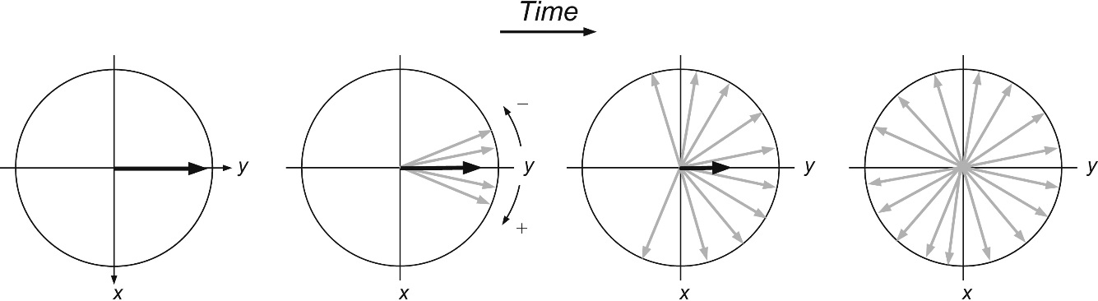
Transverse relaxation
The Larmor frequencies of nuclear spins differ slightly depending on their local magnetic field which is not identical at all points in the sample
A bulk magnetisation vector in the tranverse plane will decrease as the spins which contribute to it precess at slightly different frequencies – this is known as decoherence and occurs exponentially with a time constant T₂.
Figure 2.1.10
Transverse relaxation.
Transverse relaxation is also know as spin-spin relaxation

Slide 15
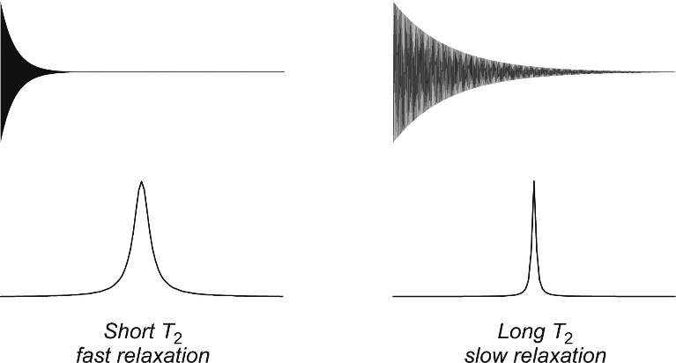
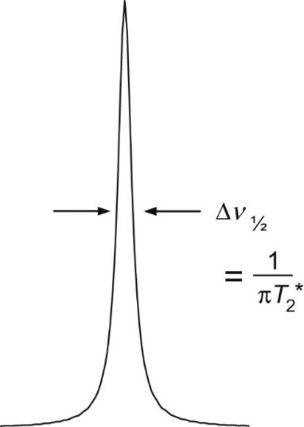
Natural linewidth
The widths of the lines in an NMR spectrum are determined by transverse relaxation
The observed transverse relaxation time constant, T₂*, has contributions from natural relaxation processes (T₂) and inhomogenetity in the magnetic field within the NMR sample
Figure 2.1.12
Definition of the half-height linewidth of a resonance.
Figure 2.1.11 Resonance linewidths.

Slide 16
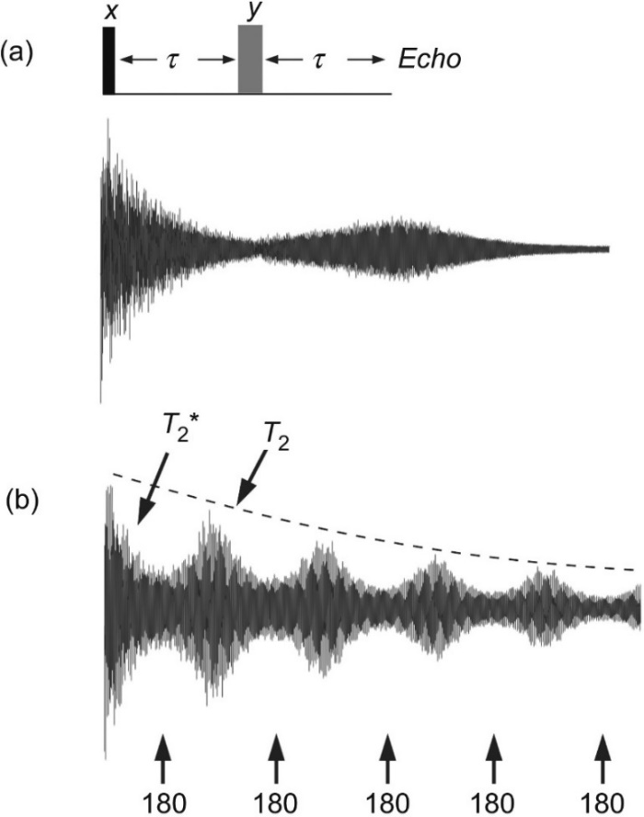
Measuring T₂
Each signal has its own T₂
As the effects of inhomogeneity (T₂*) are usually dominant, T₂ cannot normally be measured from linewidth so a spin echo sequence is used
The spin echo pulse sequence comprises a 90 pulse followed by a train of 180 pulses
Each 180 pulse refocuses the effects of inhomogeneities, cancelling them to allow T₂ to be measured
Figure 2.1.13
Experimental observation of spin echoes.
Spin echoes are also know as Hahn echoes, after their discoverer, Erwin Hahn

Slide 17
Mechanisms for relaxation
Nuclear spin relaxation is not a spontaneous process
It requires a fluctuating magnetic field to induce spins to flip
There are four key mechanisms that cause relaxation:
diole-dipole
quadrupolar interactions
chemical shift anisotropy (CSA)
spin rotation

Slide 18
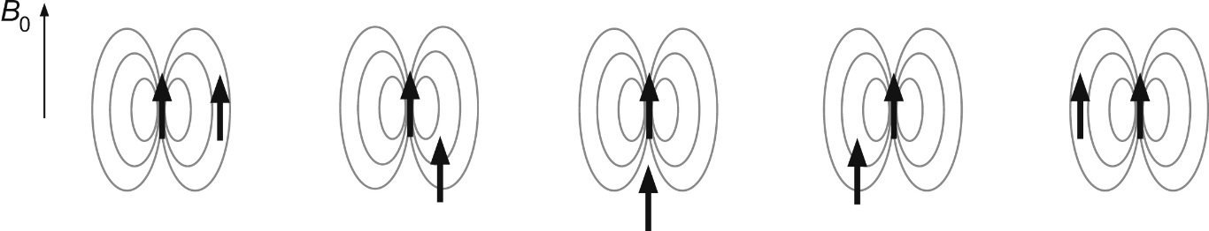
Dipole-dipole relaxation
Arises from the direct interaction between nuclear spins
Source of nuclear Overhauser effect (nOe)
As molecules tumble in solution the local magnetic fields that the spins project onto each other change, inducing realaxation
Isolated spins relax more slowly
Depends on magnetic interactions
Figure 2.1.14
Dipole–dipole relaxation.

Slide 19
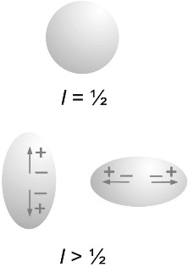
Quadrupolar relaxation
Nuclei with I > ½ have a quadrupole moment
A quadrupole is a non-spherically symmetric charge distribution within the nucleus
Interactions with the quadrupole can be very efficient for relaxation
As the molecule tumbles in solution the quadrupole interacts with nearby spins and can cause them to flip – promoting relaxation
Depends on electric interactions
Figure 2.1.15
Quadrupolar nuclei lack the spherical charge distribution of spin−½ nuclei, having an ellipsoidal shape which may be viewed as arising from pairs of electric dipoles.

Slide 20
Spin rotation relaxation and chemical shift anisotropy
A molecular magnetic moment is generated by the electronic and nuclear charges in rapidly rotating molecules or groups
The field associated with the molecular magnetic moment causes relaxation
Relaxation is most effective for small, symmetric molecules and groups, e.g CH₃
Chemical shift anisotropy results from unsymmetrical (anisotropic) electron distribution within a molecule
The local field experienced by a nucleus is dependent on the orientation between the chemical bond and magnetic field

Slide 21
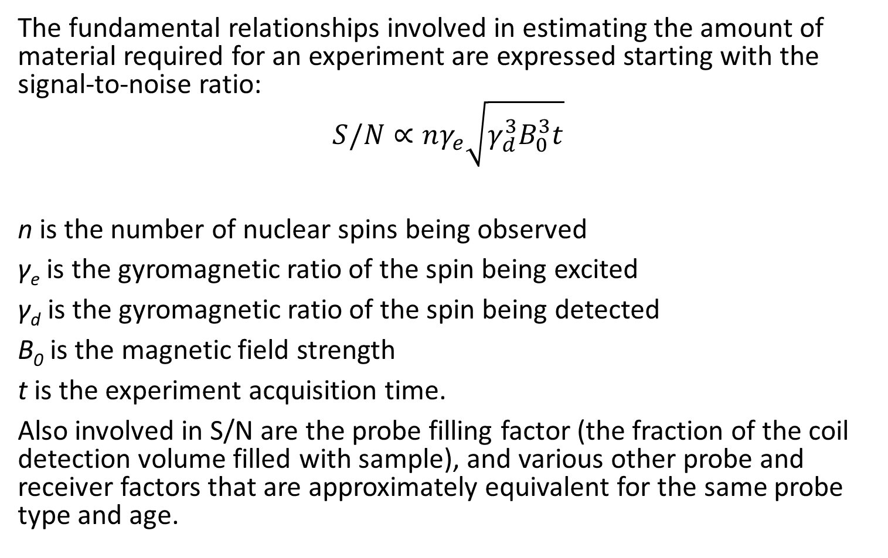
Sensitivity
The fundamental relationships involved in estimating the amount of material required for an experiment are expressed starting with the signal-to-noise ratio:
$$S/N∝nγ_{e}\sqrt{γ_{d}^{3}B_{0}^{3}t}$$
n is the number of nuclear spins being observed
γ_{e} is the gyromagnetic ratio of the spin being excited
γ_{d} is the gyromagnetic ratio of the spin being detected
B₀ is the magnetic field strength
t is the experiment acquisition time.
Also involved in S/N are the probe filling factor (the fraction of the coil detection volume filled with sample), and various other probe and receiver factors that are approximately equivalent for the same probe type and age.

Slide 22
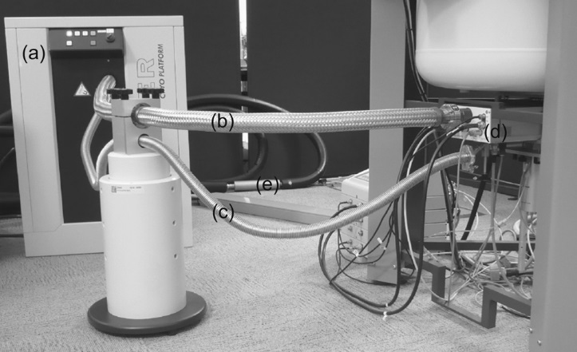
Sensitivity – Cryoprobes
Figure 2.1.16 A helium-cooled cryogenic probe installation.

Slide 23
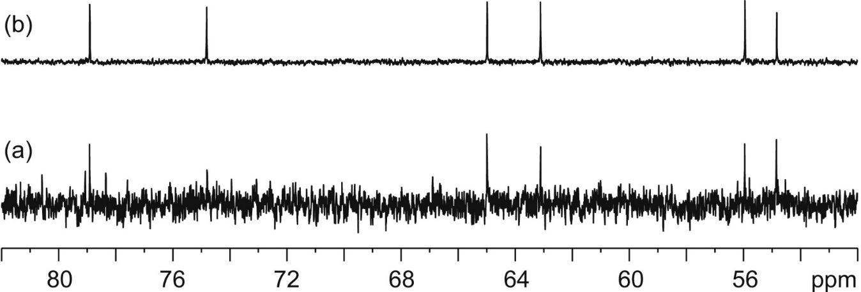
Sensitivity – Cryoprobes
Figure 2.1.17 Comparison of the carbon-13 sensitivity performance of (a) a conventional room temperature probe and (b) a helium-cooled cryogenic probe operating at 500 MHz (1H).

Slide 24
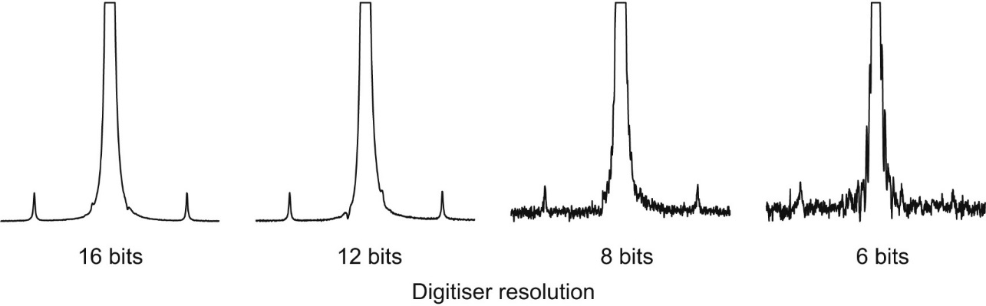
Dynamic Range
If signals coming from the probe are of a substantially different size then it is not possible for the analogue-to-digital converter to accurately digitise both.
Large or small signals are digitised but not both.
Figure 2.1.18 Dynamic range and the detection of small signals in the presence of large ones.

Slide 25
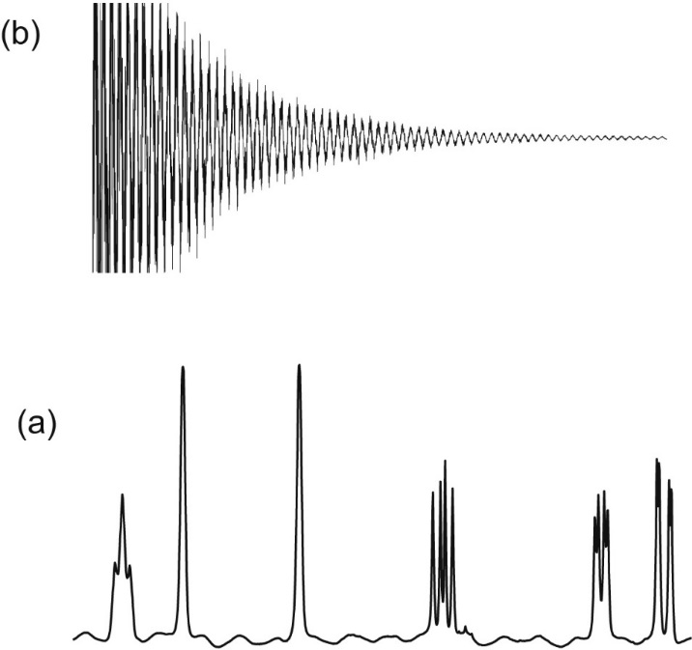
Clipping
If the signal coming from the probe to the receiver is amplified too much the analogue-to-digital converter cannot digitise it and the FID will be clipped.
Clipping gives a distorted baseline and signal lineshapes
Figure 2.1.19 Receiver or digitiser overload.

Slide 26
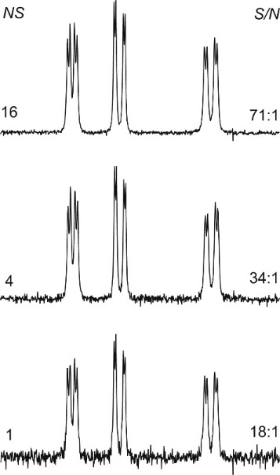
Signal averaging
Signal to noise ratio scales with the square root of the number of scans
Signal to noise ratio scales linearly with concentration
Figure 2.1.20 Signal averaging produces a net increase in the spectrum signal-to-noise ratio (S/N).

Slide 27
Relaxation, quantification, sensitivity, and signal averaging
Nuclear Magnetic Resonance – Theory and Techniques
Ralph W. Adams
ralph.adams@manchester.ac.uk

