Slide 1
Chemical Shift
Nuclear Magnetic Resonance – Theory and Techniques
Ralph W. Adams
ralph.adams@manchester.ac.uk

Slide 2
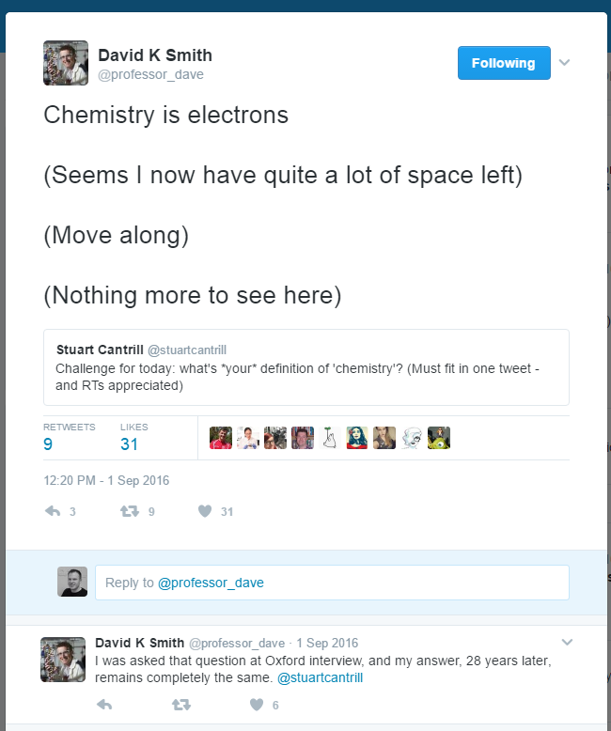

Slide 3
Chemical Shift
The origin of chemical shift
Aromatics and ring currents
Hydrogen bonding
Temperature and solvent
Isotope shifts
Typical values

Slide 4
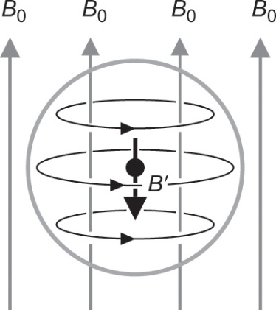
The origin of chemical shift
A magnetic field is generated by the motion of electrons, within their orbitals.
Applying an external magnetic field B₀ increases electronic motion producing an extra field B’ which reduces the magnetic field, B, experienced by the nucleus.

Slide 5
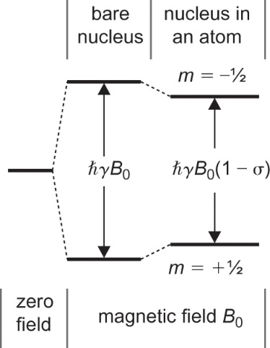
The origin of chemical shift
The Larmor frequency of a nucleus changes as a result of interaction of electrons with the magnetic field.
The nucleus is shielded so the magnetic field experienced by the nucleus, and hence the Larmor frequency, is reduced in magnitude.

Slide 6
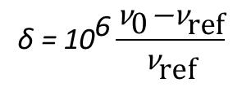
The independence of chemical shift
Chemical shift is defined so that signals occur at a value that is independent of magnetic field
This requires a reference to be used
The reference is either a real signal (e.g. TMS) or the base frequency of the spectrometer
$$\text{δ} \text{=}{\text{ 10}}^{\text{6}}\frac{{\text{ν}}_{\text{0}}\text{−}{\text{ν}}_{\text{ref}}}{{\text{ν}}_{\text{ref}}}$$
A signal which occurs at 400,000,400 Hz on a ‘400 MHz’ spectrometer will occur at 600,000,600 Hz on a ‘600 MHz’ spectrometer.
The chemical shift of the signal is 1 ppm

Slide 7
Chemical shift and electronegativity
 | CH₃F | CH₃Cl | CH₃Br | CH₃I | CH₃H
δ | 4.13 | 2.84 | 2.45 | 1.98 | 0.13
Electronegativity | 4.0 | 3.0 | 2.8 | 2.5 | 2.1
Chemical shift values scale with electronegativity as can be observed for the halogen-substituted analogues of methane.
Both inductive and mesomeric effects are important for chemical shift
OR groups withdraw electrons inductively to reduce electron density but donate electrons through mesomeric effects to increase electron density.

Slide 8
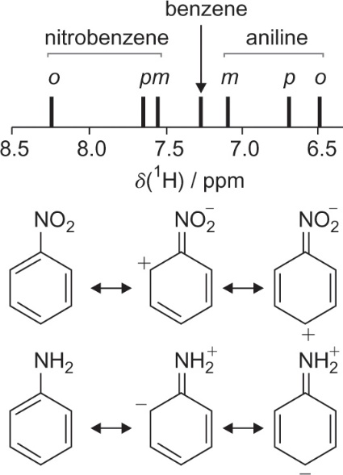
Mesomerics
The chemical shifts of the ¹H signals from nitrobenzene are shifted to a higher frequency relative to the ¹H signals from benzene.
Electron withdrawing mesomeric effects of the nitro group
Opposite occurs for aniline where the amine lone pair donates electron density into the π–bonds of the aniline

Slide 9
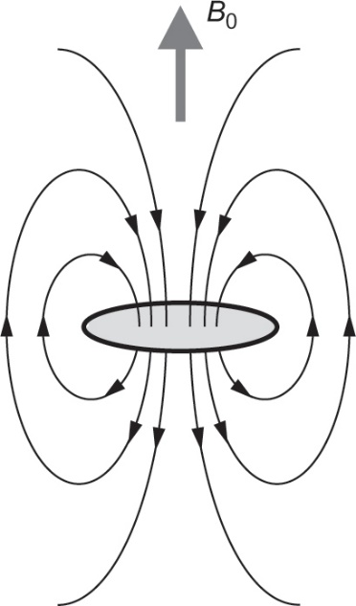
Aromatics and ring currents
The electronic structure in aromatic molecules is such that electrons can circulate in a way that will generate a current around the ring(s).
Unlike the motion of electrons close to each nucleus, these ring currents deshield nuclei by contributing positively to the magnetic field experienced by nuclei outside the ring.

Slide 10
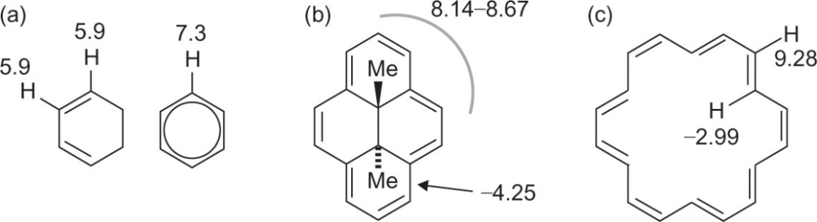
Aromatics and ring currents
a) cyclohexadiene vs benzene – deshielding occurs once a ring current is set up
b) trans-15,16-dimethyl-15,16-dihydropyrene and (c) [18]-annulene – ¹H’s on the outside deshielded and ¹H’s on the inside shielded

Slide 11
Solvent and concentration
Chemical shift is not an invariant property of a molecule and will change depending on molecular environment.
Aromatic solvents (e.g. benzene, pyridine) cause chemical shift changes as large as 0.8 ppm compared to chloroform and acetone.
Chemical shifts vary with concentration and will be particularly pronounced if strong intermolecular interactions are likely to occur. OH, NH and aromatics.

Slide 12
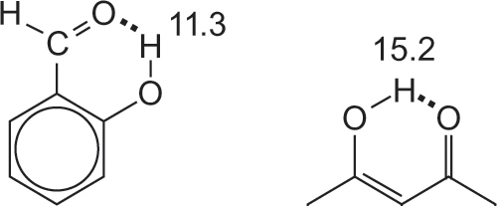
Hydrogen bonding
Intramolecular hydrogen bonding is particularly effective at increasing chemical shift
Examples shown are salicylaldehyde and the enol form of acetylacetone

Slide 13
Temperature
Chemical shift is temperature dependent.
The difference between the two chemical shifts in the ¹H NMR spectrum of methanol has almost linear temperature dependence and can be used to accurately measure temperature.

Slide 14
Isotope shifts
The vibrational properties of different isotopomers (e.g. ¹H vs ²H) differ, providing different amounts of nuclear shielding.
For ¹H/²H exchange the isotope effect is relatively large owing to the large ratio of the isotope masses.
Much smaller for other nuclei
Can be used to identify which ¹³C in a molecule has Cl attached via observation of ^{35/37}Cl isotope shifts.

Slide 15
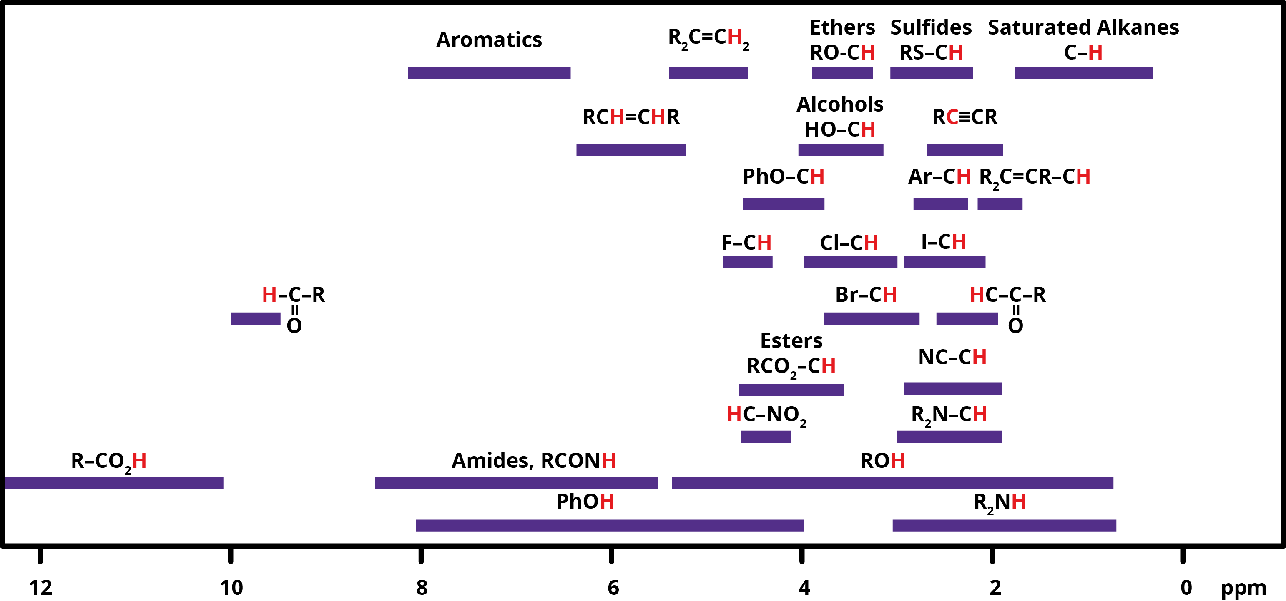
¹H Chemical Shifts

Slide 16
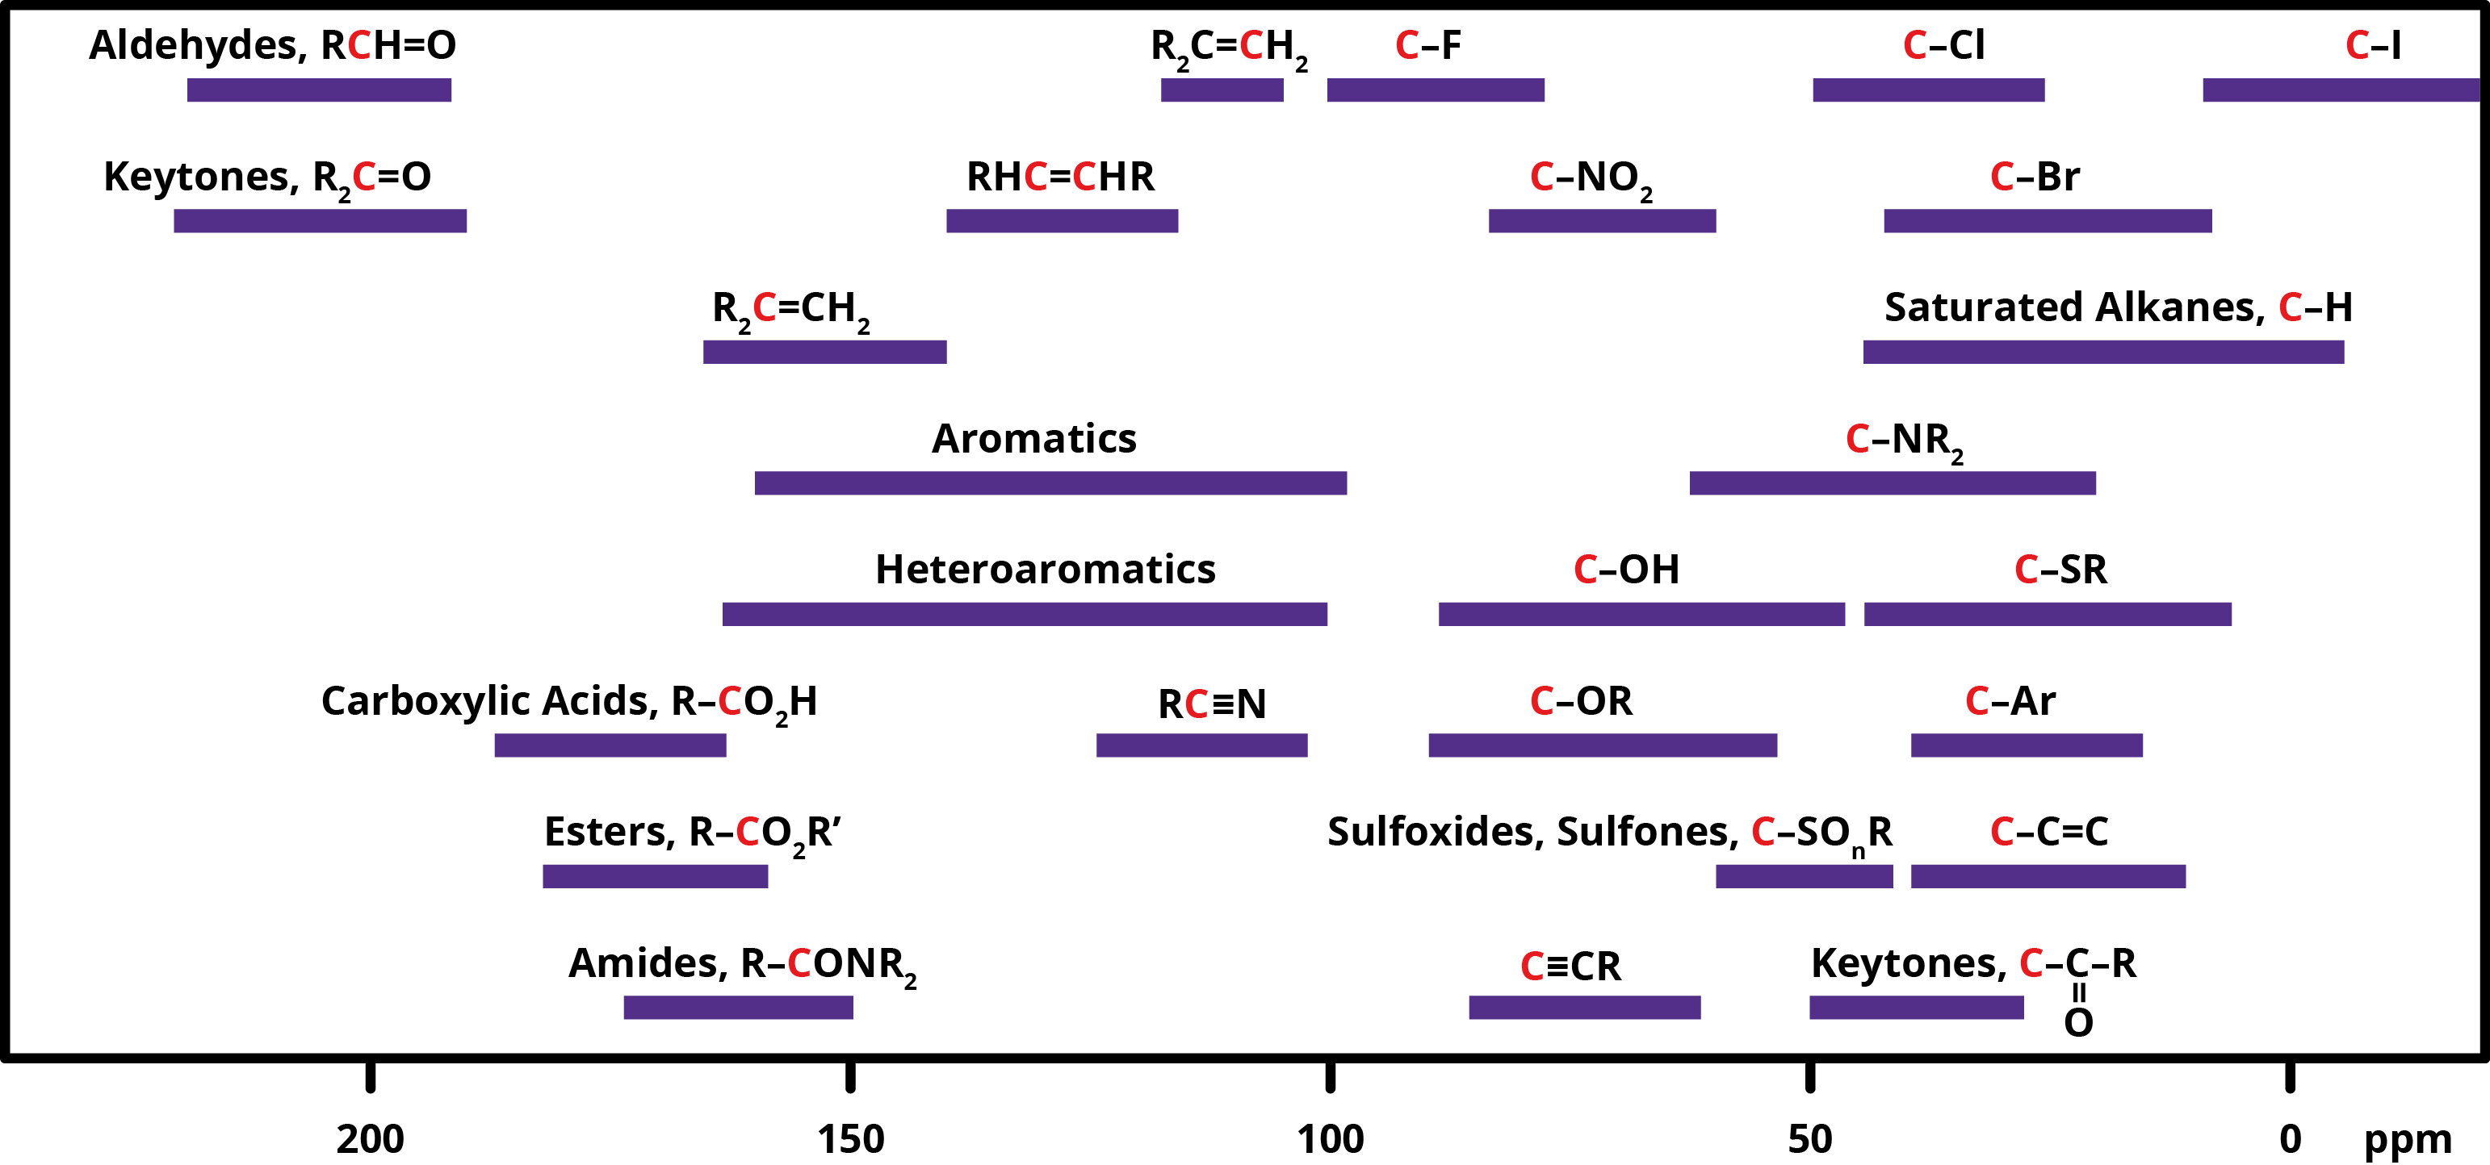
¹³C Chemical Shifts

Slide 17
Chemical Shift
Nuclear Magnetic Resonance – Theory and Techniques
Ralph W. Adams
ralph.adams@manchester.ac.uk

