Slide 1
Nuclear Magnetism and NMR Spectroscopy
Nuclear Magnetic Resonance – Theory and Techniques
Ralph W. Adams
ralph.adams@manchester.ac.uk

Slide 2
Introduction to this course
Part 1 will cover the basics of NMR theory
Part 2 will introduce and discuss the wide range of NMR methods available
Part 3 will provide several workshops, applying the knowledge introduced in the lectures
The course expands on courses run by Tim Claridge at The University of Oxford, Abil Aliev at University College London, and James Keeler at The University of Cambridge.
Much of the material will be taken from the texts Nuclear Magnetic Resonance (2e) by Peter J. Hore (Oxford Chemistry Primer) and High Resolution NMR Techniques in Organic Chemistry (3e) by Tim D. W. Claridge (Elsevier) which provide a more complete introduction to NMR spectroscopy.
Only liquid state NMR will be discussed

Slide 3
Nuclear Magnetism and NMR Spectroscopy
History
Spin angular momentum
Magnetic moments
Energy levels
Resonance frequencies and chemical shift
Populations and polarization

Slide 4
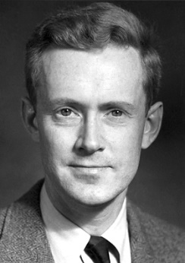
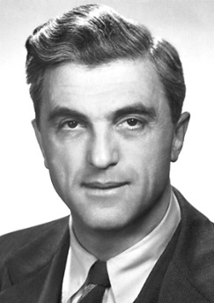
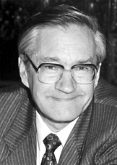
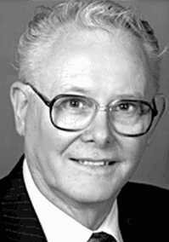
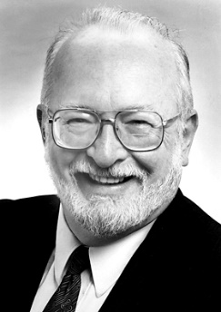
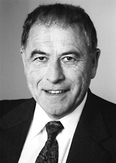
Some NMR history
1926 – Prediction of nuclear spin (Pauli)
1932 – Detection of nuclear magnetic moment (Stern)
1945 – NMR spectra of solution (Bloch*) and solids (Purcell*)
1949 – Discovery of chemical shift
1964 – Pulse FT NMR (Ernst* and Anderson)
1971 – 2D NMR experiment proposed (Jeener)
1972 – MRI Image collected (Lauterbur*)
1974 – 2D NMR demonstrated (Ernst)
1979 – 2D NOESY
1980 – NMR protein structure (Wuthrich*)
*Nobel prizes awarded in physics, chemistry (x 2)
and medicine.

Slide 5

Spin angular momentum
spin is an intrinsic property of magnetic nuclei
The magnitude of spin angular momentum is $\sqrt{\text{I} \left(\text{I}\text{ + 1}\right)}$ ħ.
I | Nuclide
0 | ¹²C, ¹⁶O
1/2 | ¹H, ¹³C, ¹⁵N, ²⁹Si, ³¹P
1 | ²H, ¹⁴N
3/2 | ¹¹B, ²³Na, ³⁵Cl, ³⁷Cl
5/2 | ¹⁷O, ²⁷Al
3 | ¹⁰B

Slide 6
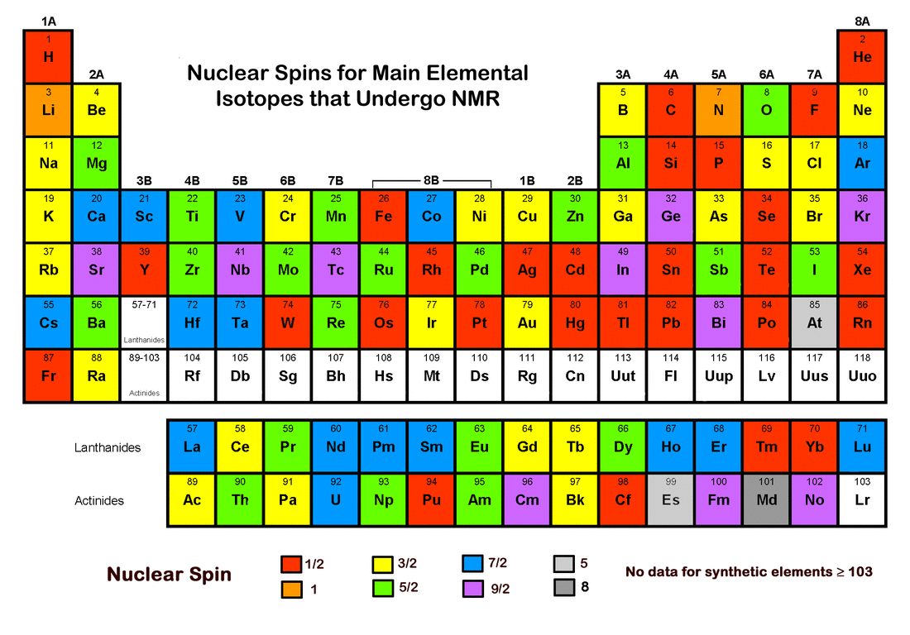
Spin angular momentum

Slide 7

Spin angular momentum
The Stern-Gerlach experiment confirms spin and quantization

Slide 8
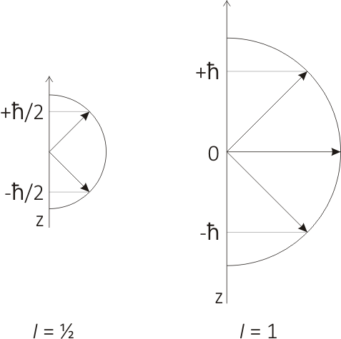
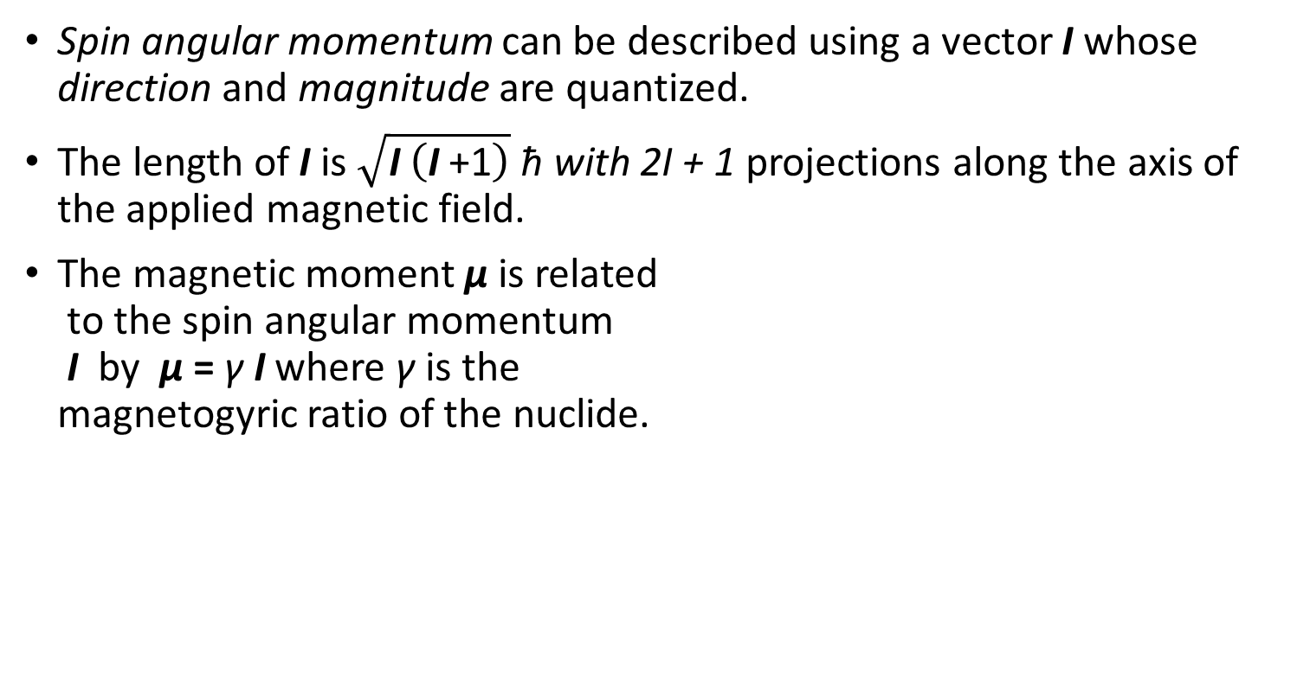
Magnetic moments
Spin angular momentum can be described using a vector I whose direction and magnitude are quantized.
The length of I is $\sqrt{\text{I} \left(\text{I} \text{+1}\right)}$ ħ with 2I + 1 projections along the axis of the applied magnetic field.
The magnetic moment µ is related
to the spin angular momentum
I by µ = γ I where γ is the
magnetogyric ratio of the nuclide.

Slide 9
Magnetic moments
Nuclide | γ ( 10⁶ rad s⁻¹ T⁻¹) | ν (MHz T⁻¹)
¹H | 267.513 | - 42.58
²H | 41.065 | - 6.54
¹³C | 67.262 | - 10.71
¹⁵N | −27.116 | 4.32
¹⁹F | 251.662 | - 40.05
²⁹Si | −53.190 | 8.47
³¹P | 108.291 | - 17.24
How do you convert from γ to ν?
What are the NMR frequencies of ¹H and ¹³C at 9.4 T and 23.5 T?

Slide 10
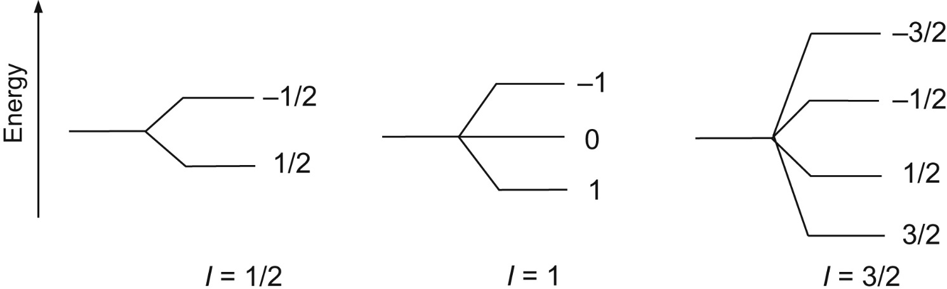
Energy levels
For strong magnetic fields the spins are quantized along the axis of the magnetic field.
The energy E of a spin is the product of the z-component of the magnetic moment µ_{z} and the magnetic field B.
µ_{z} = γ I_{z} = γ m ħ
E = - γ m ħ B.
Label the figure to give the energy for each value of m for I = 1

Slide 11
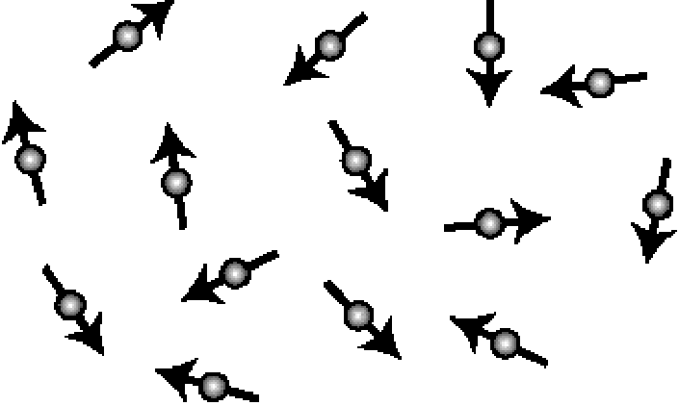
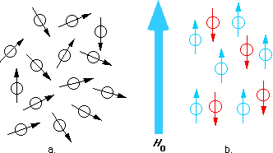
A common misconception

Slide 12
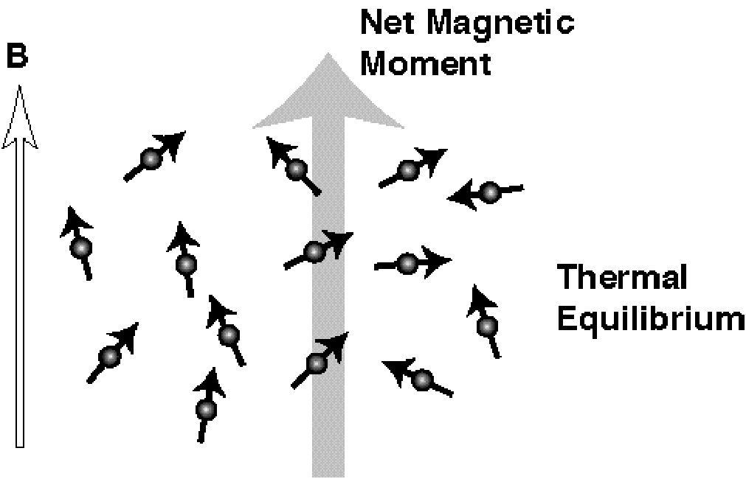
A common misconception – corrected

Slide 13
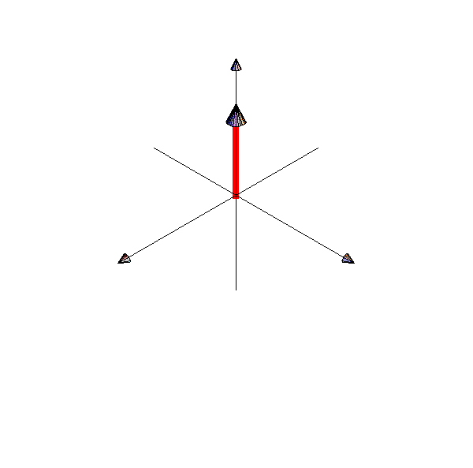
NMR spectroscopy
ν_{NMR} is in the radiofrequency part of the electromagnetic spectrum so we use the term R.F. field when discussing the radiation required to irradiate NMR transitions.
an appropriate radio-
frequency is applied to
rotate the bulk
magnetisation vector
into the transverse plane
Larmor precession is
then observed and used
to generate an NMR
signal

Slide 14
NMR spectroscopy

Slide 15
NMR spectroscopy
Angular momentum, resonance and precession can be demonstrated using a gyroscope.

Slide 16
Populations and polarization
The populations of energy levels in NMR spectroscopy can be calculated using n_{β} / n_{α} = exp(-ΔE / k_{B}T)
With ΔE = γ ħ B = 2.65 x 10⁻²⁵ J and k_{B}T = 4.14 x 10⁻²¹ J
ΔE/k_{B}T = 6.4 x 10⁻⁵
The available thermal energy, k_{B}T, is large compared to the energy required to reorient the spins and that the population difference will be small.
n_{α} = 15625
n_{β} = 15624
Population difference is only 1 in 31250 molecules so NMR signals will be very weak.

Slide 17
Nuclear Magnetism and NMR Spectroscopy
Nuclear Magnetic Resonance – Theory and Techniques
Ralph W. Adams
ralph.adams@manchester.ac.uk

